Slide 1
Using interrupted video case studies to address case-study limitations
Bill Anderson, Gabrielle Jorns, Laura Bivens
Notes:
I wanted to add “practicing theory” to a course
Searched unsuccessfully for case studies
discovered limitations in case studies
also wanted to address these limitations
Began to experiment with videos

Slide 2
FCS 408 - Human Development in Social Context
Catalog description --- Theories and research regarding human development and family dynamics and their relationship to historical time, society, and culture.
Primarily for Child Life students
Typical class
  Reading exam
  Lecture
  Scenarios and case studies
  5-minute teachings
    A two-hat technique (Herreid, 2004, 2007)
How can I incorporate more case-based application with a two-hat methodology?
Notes:
Taught since 2008
Course is usually around 10-12
5-6 Cl – 1-3 HDFS – Others from Psychology, KNR, Social Work, Nursing, And Dietetics
CLS required –developmental theory will become their native language but they come from a variety of backgrounds
A two-hat technique (Herried, 2004, 2007) –
Speak as a student in discussion or as a professional using the field’s terminology
i.e. how is that like Perry’s dualist thinking – (Suzi at 21 dropping out, chain smoking and traveling) are you thinking Piaget’s formal operational thinking should be showing up, why is there so little evidence – does Perry’s Reflective Judgment offer help here?
Neil at 21 – wanting to give back to society Piaget’s formal operational thought or --- if it sound’s like generativity why are you not labeling it as that
Discovery learning with abstract – must teach what it is and what it is not
Following an ICS format, students worked “with incomplete data, made tentative hypotheses, collected more information, refined their hypotheses, and made more predictions” (Herreid, 2004, p. 13) in weekly reflective essays and class discussions.

Slide 3
Case Based Instruction (CBI)
CBI can be a representation of the messy world of practice
However there are limitations
  Potentially a passive activity(developed from Egleston, 2013)
    Often what is being assessed is the ability to locate predetermined answers
    Some currently available case studies have responses readily available online
  Most cases are limited in length and may relate to only a few course concepts
    We may teach in blacks and white but most practice comes in shades of gray” (Herron et al, 1990)
Notes:
Wanted cases where all was not immediately relevant
White and Klein / Smith and Hamon cases – when theoretical assumptions, concepts, etc are applies more and more comes to the top.
Both limitations are addressed here

Slide 4
Case Based Instruction (CBI)
Strengths of CBI (Developed from Herreid (2007), John (2002), Mayo (2002))
  Actually tells a story and creates empathy for the characters
  Create the need to know
  Teach in context (i.e. applying, analyzing)
  Raise the level of critical thinking required
  Connecting theory to practice
"A good case has ambiguities and it requires space to give a richness of texture to a story. The audience never knows how it will all come out..." (Herreid, 2007b, p. 48).
Notes:
Wanted cases where all was not immediately relevant
White and Klein? Smith and Hamon cases – when theoretical assumptions, concepts, etc are applies more and more comes to the top.

Slide 5

How can I address the limitations and maintain the strengths?
Egleston’s (2013) idea that a progressive case-study could address all limitations typically associated with CBI
Mayo (2004), in reflecting on these difficulties, stated, "a promising direction for CBI might involve the combination of video technology and case method of teaching" (p. 144). The current study does exactly that.
Notes:
Can interrupted video case studies:
Create a need to know
Raise the level of critical thinking
Connect theory to practice
Can IVCS provide vicarious, but meaningful, learning relevant to the course?
Can IVCS produce noticeable learning gains for graduate students? Pre-Post
Can an interrupted video case-study, as suggested by Egleston (2013), address limitations typically associated with case-based instruction?
, in this case an interrupted video case-study, could address all limitations typically associated with case-based instruction. Moreover, and although some (e.g. Egleston, 2013) have reported that students have expressed some dislike for the less structured format that might accompany case-based learning, that was not an issue in this current study. At the conclusion of the assignment, and in agreement with Mayo (2002), students here were very favorable concerning CBI, as well as the interrupted format.

Slide 6
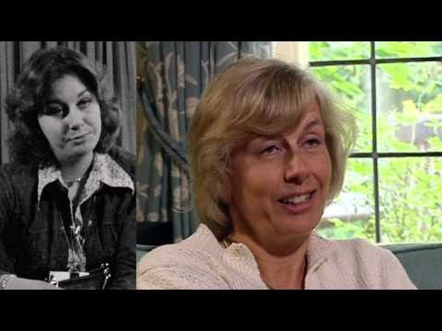
Interrupted Video Case Studies – 56-UP

Slide 7
The assignment
Students will, at eight points in the semester, view individuals in a longitudinal case study. At each point, students will
  (a) briefly describe where their subjects are in their lives and why,
  (b) review the accuracy of recent conclusions or predictions and respond, and (
  c) make knowledgeable, theoretically informed predictions of who/where their subject(s) will be in seven years.
Specifically identify theories used and why they were chosen. 1-2 pages per entry will be sufficient, due before the next class.
Identify
Assume
Distinguish
Infer
Prioritize
Elaborate
Imagine
Predict
Notes:
Case studies challenge students to identify with the individuals within context; interrupted case studies use a progressive disclosure of information rather than presenting the entire event/conclusion at the outset.
How did this address the limitations?
How did this build the strengths?
Additional strengths of 56-Up? Real people and real lives.

Slide 8
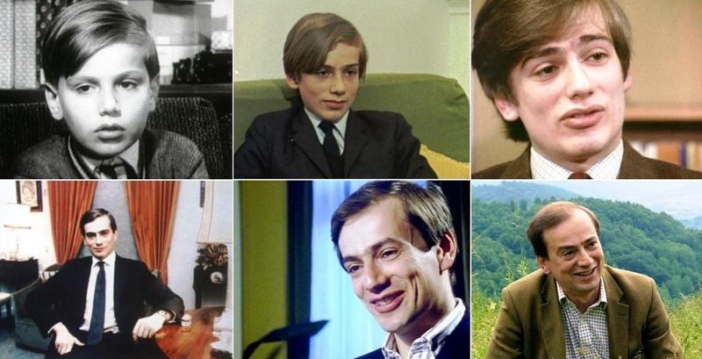
John

Slide 9
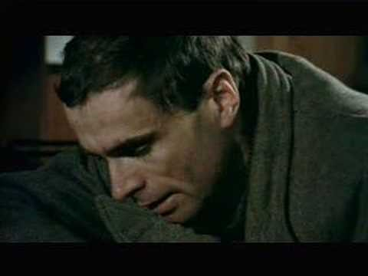
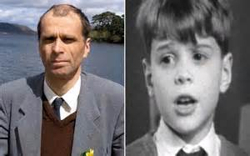
Neil
Why did you choose Neil?
What did you learn about applying developmental theory?
How did the way you approached the subject and/or the assignment change over time?
When and what did you begin to feel about the application of theory?
How was this assignment different from previous studies with theory?
Notes:
The questions are not set in stone and your also not limited to these.
When possible use quotes from your work, whether a question or a conclusion. Also consider quotes from your work that you later modified, strengthened, or changed your mind about.
Has this influenced your use of theory in your thesis? How?
About 4-5 minutes

Slide 10
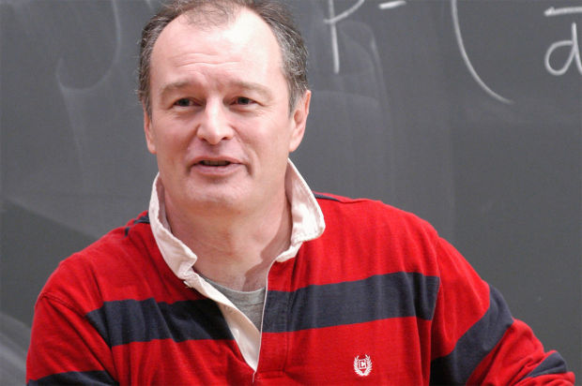
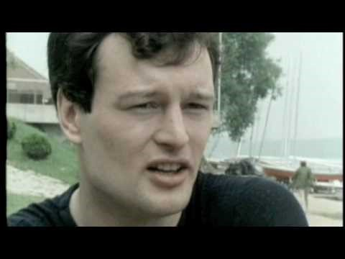
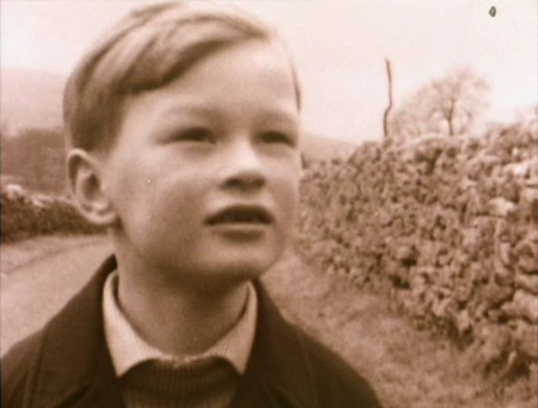
Nicholas
Why did I choose Nick?
What did you discover about Erikson, Marcia, …?
Did you question yourself or __________ when writing essays?
Changing my approach over time…
When and what did you begin to feel about Nick?
How was this assignment different from previous studies with theory? From Family Science theories covered in FCS401?
Learning from watching other participants…

Slide 11
Findings
Method
Results
Pre-/Post-Test
Coding student essays for Pattern-Matching (Yin, 2009)
Pre-/post-test scores were analyzed using a paired-samples t-test. The effect was significant, t(20) = -7. 990, p = .000.
  For all participants the posttest score was higher, moving from a mean pretest score of 17.65/39 (SD – 3.26), or 45% to a posttest mean of 33.11 (SD – 3.05), or 85%.
  This indicated a mean student improvement of roughly 40% (SD – 2.72)
Notes:
Pattern-matching is a more formalized lit review.
Unlike open coding to determine a theory, the lit review becomes what is anticipated, including the order in which things should unfold.
Added Revise Bloom’s taxonomy as codes

Slide 12
Coding student essays revealed
 | Essay 2 - 14-Up | Essay 8 - 56-Up
Creating | 7.3% | 11.6 %
Evaluating | 8.1 % | 16.7 %
Analyzing | 17.7% | 35.1 %
Applying | 11.2% | 6.3%
Understanding | 19.1 % | 9.1%
Remembering | 36.6 % | 28.9 %
Notes:
Intercoder reliability, of three independent coders, was computed to determine coding consistency/reliability. After two coding passes, analysis utilizing Cronbach’s alpha yielded scores of a = .846, p = .01, for student essay #2 and a = .818, p = .01, for essay #8.
This high correlation indicated a high likelihood of pattern-matching and a strong construct validity (e.g. Yin, 2009) as well as an increase toward higher, more complex, levels of thinking across student’s written essays, further explaining, and validating, pre-/post-test results. The table shows changes in taxonomy levels (Anderson & Krathwohl, 2001), with #4, analyzing (i.e. comparing, inspecting, discovery), and #5, evaluating (i.e. interpreting, prioritizing, justifying, explaining), both approximately doubled at the final essay.
NOT LIMITED IN LENGTH
NOT A PASSIVE ACTIVITY

Slide 13
The interrupted video case study format was successful
Creating the need to know/Creating empathy
  I love the fact that Nicolas (at 21) said he does not worry about not achieving and he just wants to see where he ends up… I’m excited to see where Nicolas goes next.
  Suzi (at 21)is lost! However she could be a dark horse and surprise me. I cannot wait to find out
  … was I thinking theory or not seeing past what I was hoping for Neil (at 42).
  I’m not sure I know what to make of this. Neil (at 42) says that people thought he was a success and that when people wrote him they said that they could see something in him that Neil couldn’t see in himself. I too see what they see in him.
Notes:
Fink – curiosity about the material and myself
Because, “a learning experience changes the degree to which students care about something… in the form of new feelings, interest, or values” (Fink, 2003, p. 32).
Without a change in caring, or value, no significant learning occurs (Fink, 2003).
This need to know (e.g. Herreid, 2007b) was often visible in student curiosity in 56-Up.

Slide 14
The interrupted video case study format was successful
Raise the level of critical thinking
  I may be assuming his experience is reflective of mine but I think that the distant relationship Neil has with his family might be for a reason that we have yet to see in his interviews. The Neil in 42-UP seemed less poetic… I got the impression that he might be using a drug therapy to manage his illness. I also didn’t see the “sparkle of the 7-year old eyes” …felt like meeting a whole new person in a way. I hope he remains in good health, but I am worried.
  I don’t think that Suzy will be fully into the next psychosocial stage by 56, because the questions and answers included were directed at a reflection of the past and very little was discussed of the future. So, naturally she appeared focused on her past.
  I would like to predict that his (Neil at 42) life becomes a little more stable, but I’m not sure if that is a true prediction or just a hope.
Notes:
As, “Factual knowledge exists at a relatively low level of abstraction” (Anderson & Krathwohl, 2001, p. 45) students were encouraged to elaborate, infer, interpret, imagine, and predict.
As, “many students do not make the important connections between and among the facts they learn in classrooms and the larger system of ideas reflected in an expert’s knowledge of the discipline” (Anderson & Krathwohl, 2001, p. 42), this connection was the primary goal of the interrupted case study assignment.

Slide 15
The interrupted video case study format was successful
Connect theory to practice
  Suzy (at 28) exceeded all my expectations because she was a wife and a mother. Perry stated that commitment in relativism is recognizing choices, accepting responsibility for their consequences, and willingness to accept others' right to their own choices. She may continue to reaffirm or reject old beliefs; either way, the decision is based on a conscious consideration of alternatives as opposed to the blind acceptance of the dualist.
  Nicolas also demonstrated a form of thinking between relativism and commitment… however it depends on the person’s developmental niche and personality. Nicolas was able to prioritize the options he had…
  Neil (at 56) said that he was absolutely sure that his faith helped him through difficult times. Neil has found a Bible group… along with doing his work as a politician and working in the church again shows signs of, I believe, generativity. But then we have been describing Neil this way since he was 28 haven’t we?

Slide 16
Next…
Utilize 21-Up South Africa
PPCT elements of Bioecological Theory
Questions?

Slide 17
Work on this project was supported by a 2016 SoTL Small Grant from the Office of the Cross ENDOWED Chair in SoTL at ISU.

