Slide 1
Start where you are
Arundhati Bhattacharya

Slide 2

Finding your voice
Culturally Responsive Teaching-Creating harmony among learners as individuals and as a group
Notes:
NOTE:
To change the image on this slide, select the picture and delete it. Then click the Pictures icon in the placeholder to insert your own image.

Slide 3
Life experiences- challenges to ‘diversity’
My experiences with negative perceptions
Making sense of negative perceptions:
Cultural reactions?
Are those who feel ‘othered’ over-sensitive?
Fear of the unknown- or is it Xenophobia?

Slide 4
Converting Life experiences into teaching strategies
Step 1- Self Assessment or making connections with yourself
We all come into classroom with prejudices, perceptions and world-view.
Acknowledging your own personal and subjective world-view that would spill upon the class.

Slide 5
Cultural Self-Assessment
Ask yourself-
What is my idea of diversity?
What is my idea of Race? [Is it Biological or a social construct?]
What is my idea of knowledge?-
What is my idea of reality?-
[Is it Transformative or static?]
This Self Assessment was inspired from the work of K. D. Bromley. (1998): Language art: Exploring connections. Needham Heights, MA: Allyn & Bacon

Slide 6
Do I know my students?

Slide 7


Step-2 Teacher-student connection
The Dialogue

Slide 8
Things to remember in dialogue facilitation
Goals of the dialogue
It is a Learner-centered process

Slide 9
What is the goal of dialogue?
Making and un-making of ideas, transformative knowledge…not reproductive knowledge. Lending each student a voice.

Slide 10
How to foster a learner-centered transformative dialogue?
Paulo Freire- Pedagogy of the Oppressed (1970)
Dialogical knowledge acknowledges that dialogue happens mediated world and not a vacuum.
Acknowledges diversity and wants education to be transformative and NOT reproductive.
Creating new knowledge and not having a Banking model of knowledge.

Slide 11
Proper dialogue can happen when there is-
Humility
Faith
Hope
Critical Thinking
(Freire, P., 1993, p. 91-92)

Slide 12
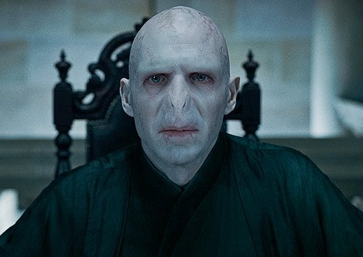
Step-3 Mention Lord Voldermort-
Or
Make the most difficult conversations. It is important to discuss uncomfortable topics specially with young adults and allow them to think and articulate their learning points in a group setting. You are still there as the facilitator but stepping back…

Slide 13
As an example
Discussing Black Radical Traditions in a mixed class…difficult as it challenged our lifelong ideas related education, religion and race.
How we articulated our life experiences while reflecting back on the readings.
How I found a voice…

Slide 14
Steps of teaching strategies-
Step 1
Do I know myself?
Identifying your fears…even if you are from the mainstream
Step 2
Do I know them?
Want to know…
Step 3
Dialogue
When do conversations become a Dialogue?
Step 4
Transparency
Difficult conversations…are needed.
Be open to difficult questions
Overcoming fear through self assesse…
Create the conditions for Dialogue…set the stage

Slide 15
Culturally Responsive Teaching-Creating harmony among learners as individuals and as a group
In Summary:
Teaching-learning is mediated through the world and life-experiences. We are all defined by cultures and life experiences.
Culturally responsive teaching acknowledges the individual variations in culture and life experiences and lending each individual their voice.

Slide 16
References
Freire, P. (1993). Pedagogy of the Oppressed. 1970. New York: Continuum, 125.
Bromley, K. D. A. (1992). Language arts: Exploring connections. Allyn and Bacon, Order Processing, PO Box 11071, Des Moines, IA 50336-1071.
Montgomery, W. (2001). Creating culturally responsive, inclusive classrooms. Teaching Exceptional Children, 33(4), 4-9.

