Slide 1
Let’s Talk
About
Character
Presenters:
Dr. Phyllis McCluskey-Titus, EAF
Jim Almeda, Health Promotion and Wellness
Nikki Brauer, Health Promotion and Wellness
Kerri Calvert, Health Promotion and Wellness

Slide 2
What does character
mean to you?
Notes:
5 minutes
Kerri – What does character mean to you? What brought you to our session today?
Character definition: Character strengths are who we are at our core. Talents are what we do well, skills are what we have proficiency in and interests are passions in what has engaged us definition from Mindfulness and Character Strengths, Niemiec, pg 113).
Why we are discussing character:
Define character:

Slide 3
Why is talking
about character important?
The measure of a man's real character
is what he would do if he knew
he would never be found out.
Thomas Babington Macaulay (English poet, 1800-1859)
Notes:
Why is character important in a college classroom or in our student groups? Have you seen any issues come up with your students where character could be part of the discussion?

Slide 4
The Science of Character film
https://www.youtube.com/watch?v=U3nT2KDAGOc
Notes:
Jim – 10 minutes

Slide 5
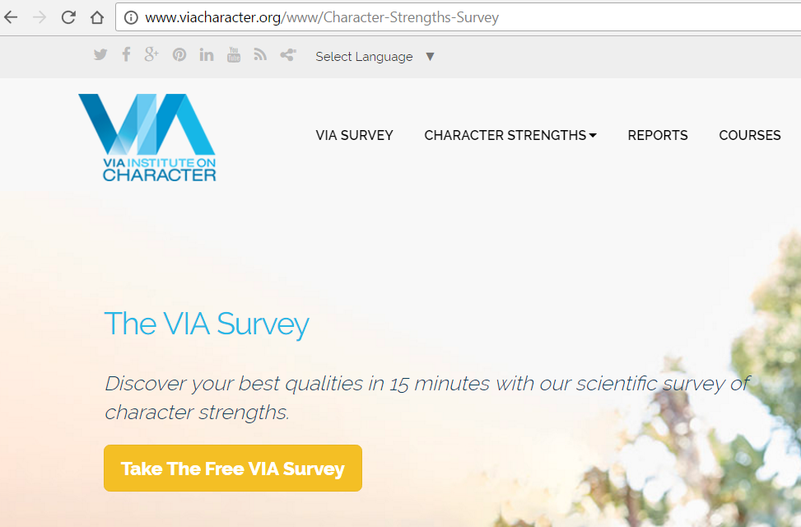
Notes:
Jim 2 minutes

Slide 6
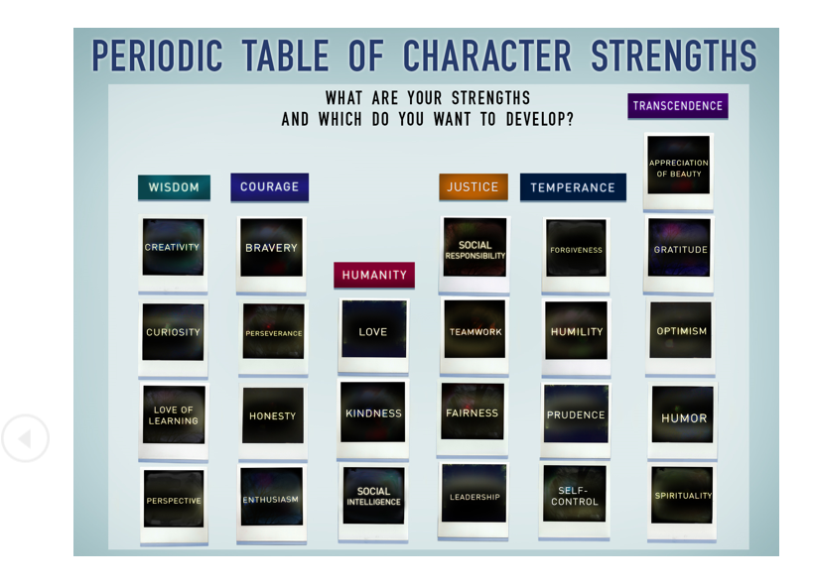
Notes:
3-4 minutes
These six virtues: wisdom, courage, humanity, justice, temperance and transcendence are common among almost all religious and philosophical traditions. Author noted below and colleagues reviewed the following:
Aristotle/Plato, Aquinas and Augustine, Old Testament and the Talmud, Confucius, Buddha, Lao-Tze, Bushido (samurai code), the Koran, Benjamin Franklin and the Upanishads)
The character strengths are the “route” by which we achieve the virtues
Cited from Authentic Happiness, Martin Seligman, pp 132-133

Slide 7
Character Day Presentation
40-50 minutes total
Outline includes a discussion guide, image of the periodic table of character strengths, and an infographic about the character strengths
5 minutes: Introduce Character Day and/or the Importance of Character
http://www.letitripple.org
10 minutes: Watch The Science of Character film http://www.letitripple.org/films/science-of-character/
20/25 minutes: Use the Periodic Table of Character Strengths, questions from the discussion guide (attached), and/or results from self-assessment (complete before presentation and bring personal ranking with them)
http://www.viacharacter.org/www/Character-Strengths-Survey
5 Minutes: Wrap Up
Notes:
2-3 minutes
Jim – HPW will provide you will all the materials; here is a sample lesson plan

Slide 8
2016 Character Day Feedback
Students
Character Day survey given in two settings
37/39 Found film to be very/somewhat positive
38/39 Yes strongly/yes somewhat agreed learning about character would make a difference in their lives
Instructors
1) First, the lesson plan was great to have. I knew I wanted to incorporate character video and assessment into my leadership course and this made it so much easier. I used the discussion questions to help focus the lesson. Went over very well.
2) I used it (the lesson plan) and it went really well. They liked the table of elements chart and felt like it really helped them look at their strengths.
Notes:
5-10 minutes
Jim, Kerri, Nikki to discuss how we used this in our classes
Also: Delta Zeta presentation, SWAT, social media presence

Slide 9
Small Group Discussion
How is this issue relevant with students you work with?
How could you use this topic in your classes or student groups?
Notes:
5 minutes
Nikki to introduce questions

Slide 10
Large Group Discussion
Notes:
5-10 minutes
Phyllis to lead

Slide 11
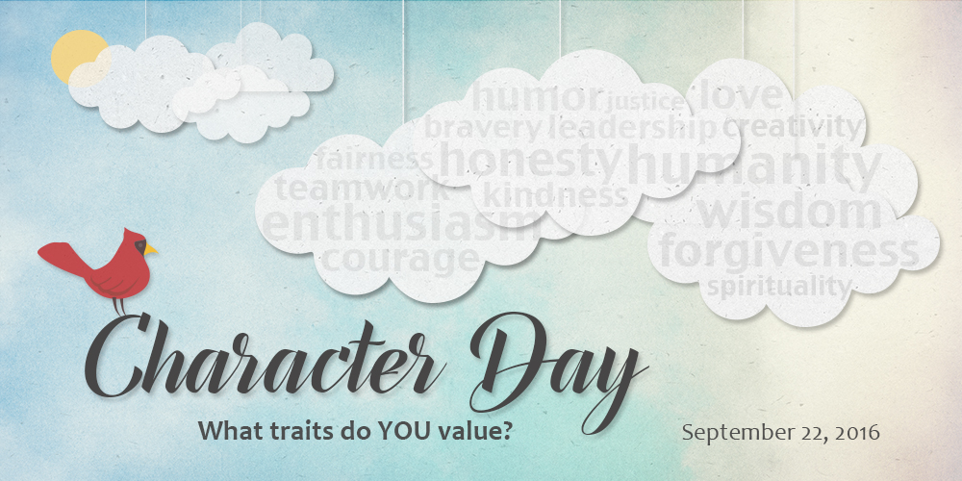
Character Day September 13, 2017
Notes:
Phyllis to mention how she will be incorporating into her class this fall

Slide 12
Wrap Up!
Questions/Comments

Slide 13
For more information
Health Promotion and Wellness
Campus Box 2120
187 McCormick Hall
309-438-9355
Wellness.Illinoisstate.edu

