Slide 1
Trigger warnings
Can enhance the academic environment

Slide 2
Introductions
Ashley Fritz, Deputy Title IX coordinator
Lori A. Henehan, MS, CRC; Coordinator of Accommodation Services, Student Access and accommodation services
Gail Trimpe-Morrow, M.S., L.P.C., Staff Counselor & Coordinator of Sexual Assault Prevention and Survivor Services, Student Counseling Services

Slide 3
agenda
Snap Shot of our Students
What Happens when A Student is Triggered
Types of Triggers
Why Trigger Warnings Matter
Help Crafting a Trigger Warning
Resources
Notes:
Lori

Slide 4

Snapshot of our Students
Last Academic year: 10,937 appointments with 1,842 students
20% increase in demand since fy 14
Sexual Assault: 20% of college women, 6% of college men
Rising Numbers of Disclosed Disability: Currently at 3%, 3.9 times Increase with Mental Health Condition
LGBTQ Disclosed Status- 1 in 6 college students (American Psychological Association)
Mental Health issues
Suicide
Notes:
Lori

Slide 5
An “emerging epidemic” of mental health problems in late adolescence and young adults:
An estimated 26% of Americans ages 18 and older live with a diagnosable mental health disorder.
Half of all serious adult psychiatric illnesses (including major depression, bipolar disorder, anxiety disorders and schizophrenia) start in late adolescence or early adulthood; 75% are present by age 25.
Suicide is the 2nd leading cause of death among college students (1,100 students each year).
Over 50% of college students have had suicidal thoughts and 10% of students seriously consider attempting suicide.
Of students being seen at university counseling centers, 24.5% were taking psychotropic medications
Notes:
Lori

Slide 6
Question:
How would you respond if a student experienced a triggering event in your classroom?
How would you know the student had been triggered?
Notes:
Lori

Slide 7


trigger
Something that sets off a memory which takes the person back to the traumatizing/extremely disturbing event
being “triggered” – destabilizes an individual; overwhelming sense of anxiety, depression, or panic
Thinking is overpowered by emotion
NOT simply being uncomfortable or challenged by content
Notes:
Gail

Slide 8
Triggers
sensory information that activates the memory of a previous traumatic/ extremely disturbing event
The individual reacts to this memory with an emotional intensity similar to the original event
we perceive a danger, whether or not it is real
This information is received by the amygdala, a part of the brain that controls responses to fear/threat; when activated, it responds
Notes:
Gail

Slide 9
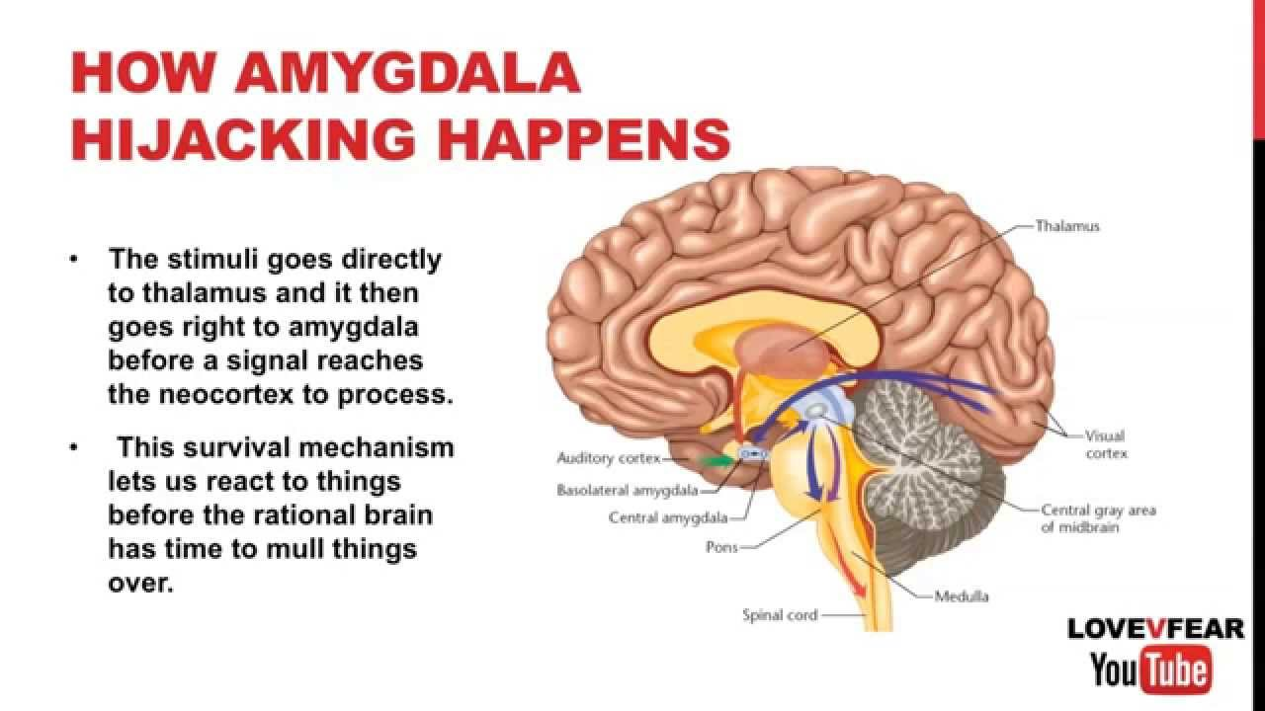
Neurobiology of triggers
The “Survival Brain” hijacks the “thinking Brain”
Amygdala reacts 80 to 100X faster than rational brain
Little or no ability to rely on rational reasoning
Notes:
Gail

Slide 10
What is a trigger warning?
“Trigger warnings, then, should be considered textual or verbal signals designed to warn those who have psychological trauma—and not necessarily only PTSD—of content which may lead to psychotic, delusional, or otherwise disordered and harmful experiences.”
Lockhart, Eleanor Amaranth. "Why Trigger Warnings Are Beneficial, Perhaps Even Necessary." First Amendment Studies 50.2 (2016): 59-69. Web.
Notes:
Gail

Slide 11
Not a requirement. Not censorship.
Rather than allowing for avoidance of content, a trigger warning allows students to prepare to engage with content
Allows students to better manage their reactions; students have the responsibility to develop coping strategies
“Trigger warnings don’t censor conversations, they start them. They are a watch-out-
for-those-rocks sign, not a keep-out sign.” Ruby Dutcher
Notes:
Ashley

Slide 12

What are potential triggers in the classroom?
Sexual Violence
Relationship Violence
Racism and Racial Violence
Ableism
Bullying
Violence against LGBTQ+
Genocide
Notes:
Gail/All

Slide 13
Why does it matter?
Federal compliance and ADA Accommodations
Intellectual engagement vs. emotional avoidance
Classroom diversity of experience and thought
Creates more inclusive classroom community
Notes:
Ashley

Slide 14
Engagement and diversity
Forewarning can alleviate/eliminate experiencing sudden shock or trauma that pulls student out of content
Shock can lead to a student being unable to analyze a text from an academic perspective
Helps to ensure transparency in the classroom
Foster authentic discourse – not a safe space as in protected, but safe in that a student will be heard
“dialogue and discussion may occur only after individuals perceive trust and respect.”
Hickey, Jeremiah. "Exempting the University: Trigger Warnings and Intellectual Space." First Amendment Studies 50.2 (2016): 70-82. Web.
Notes:
Ashley

Slide 15
When to give a trigger warning
On the syllabus
Be specific – does the course need a warning, or just specific content on a specific date?
In Prior class and/or electronically prior to the class date with triggering material
At the start of the class – Does not allow student the opportunity to prepare to engage w/content
Notes:
Lori

Slide 16
Crafting a trigger warning
Note the specific content and context you think may be triggering for individuals who have experienced trauma(e.g. “warning for graphic depiction of sexual violence”; “Content Warning: Suicide”)
Be concise. You do not need to provide a rationale for your decision to provide a warning.
Be prepared to share resources for students who may have triggering or difficult responses (Student counseling services, student access and accommodations services, Redbird CARE, Title IX)
Be open to conversations with students regarding the content
Notes:
First point: Gail
Concise: Ashley
Prepared: Lori
Open To: Ashley

Slide 17
Example for your Syllabus
Course Content Note
At times this semester we will be discussing historical events that may be disturbing, even traumatizing, to some students. If you ever feel the need to step outside during one of these discussions, either for a short time or for the rest of the class session, you may always do so without academic penalty. (You will, however, be responsible for any material you miss. If you do leave the room for a significant time, please make arrangements to get notes from another student or see me individually.)
If you ever wish to discuss your personal reactions to this material, either with the class or with me afterwards, I welcome such discussion as an appropriate part of our coursework.”
Johnston, Angus. “Why I’ll Add a Trigger Warning,” , Inside Higher Education: May 29, 2014

Slide 18
Warning for your Syllabus
At times this semester, we will be reviewing topics such as: _____________. Please review the syllabus ahead of time to make yourself aware of the topics that will be presented and their timing. As part of the discussion for this course, students are encouraged to share their thoughts. If thoughts become overwhelming, traumatizing, or get in the way of your studies, The university has several resources available to you.
Student Counseling Services: http://counseling.illinoisstate.edu/
Student Access and Accommodation Services: http://studentaccess.illinoisstate.edu/
I also welcome conversations regarding the material either with the class or with me afterwards as an appropriate part of our coursework.

Slide 19
Verbal In-Class Warnings
As a reminder, Next class we will be discussing:___________________. Because of the topic, this material could be disturbing. Please come to class prepared to engage in this content. If you have any concerns, please do not hesitate to contact me before or after class.

Slide 20
Resources for:
Help crafting a trigger warning
  Center for Teaching and Learning – Dana Karraker and Mayuko Nakamura, Also Hot Moments Podcasts
  http://ctlt.illinoisstate.edu/podcast/2016/ep015.shtml
Help accommodating a student’s request regarding work, attendance, or materials
  Student Access and Accommodation Services
Helping a student report or access resources
  Student Affairs Title IX
  Student Counseling Services
  Redbird Care Team
  A Guide to Helping Students Get help (Dean of students)
  http://studentaffairs.illinoisstate.edu/who/safety/help.php

