Slide 1
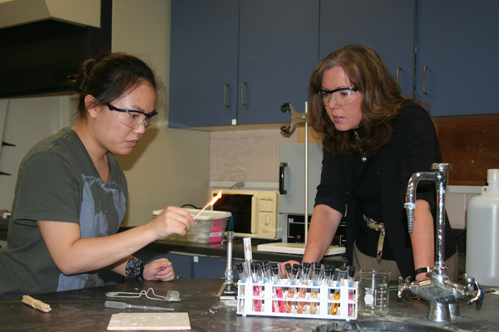
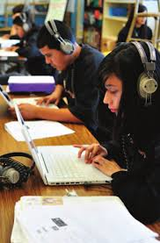
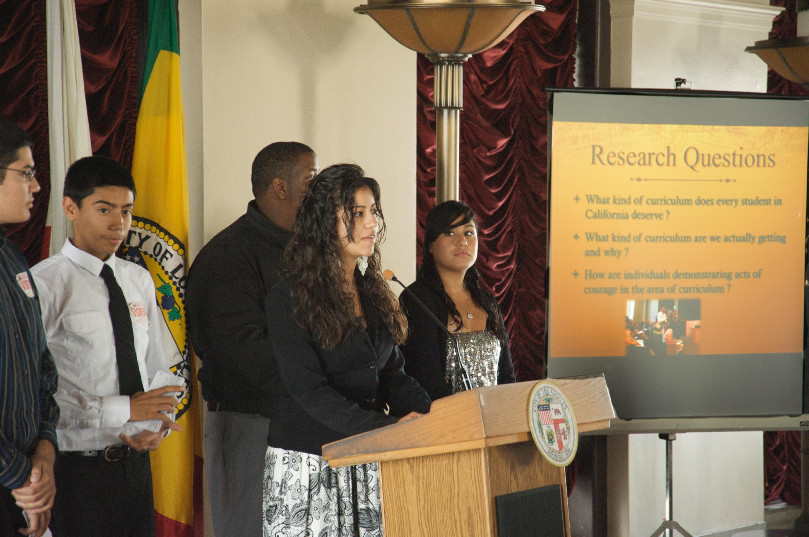
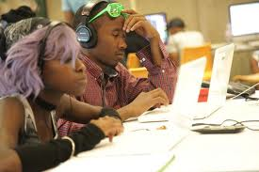
New Directions in College Teaching:
Community & Civic Engagement for Diverse 21st Century Classrooms
Notes:
Briefly describe the set up of the summer seminars and the research studies.
The seminar invited a group of working class Latino and African American youth to read seminal works in sociology of education and participate in a set of mini-research projects around the broad theme of "Race, Class, and Access in American Education." While all of the student participants had recently completed 10th grade at a local high school, they represented a fairly broad range of academic backgrounds. Over the course of three intensive weeks of study, the high school students worked in five member teams to produce a piece of original research that they presented to a panel of university faculty members with expertise in the area of educational sociology.
One research group in particular studied the impact of hip-hop music and culture on high school students in America and the implications of this impact on how teachers approach the standardized curriculum. This group created and disseminated a survey to high school students and conducted interviews with teachers, friends and family, and undergraduates at a nearby university.
Talk about outcomes associated with the Hip-hop research:
Development of traditional and critical research skills.
Gained mastery in the research article and the conference presentation as genres.
Used research on hip-hop music and culture to advocate for social and educational justice (presentation to teachers, lectures to TE programs, develop curriculum for eight graders coming to the HS.

Slide 2
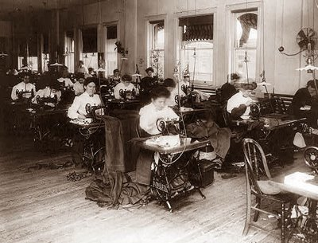
Socially, Culturally, & Digitally Relevant Instruction

Slide 3
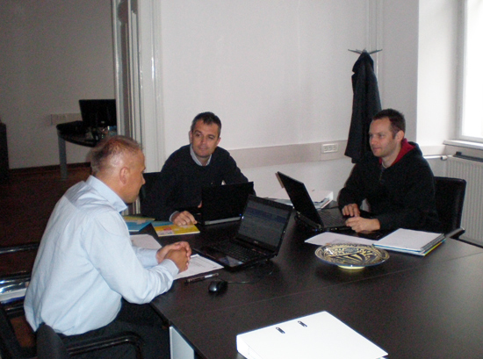

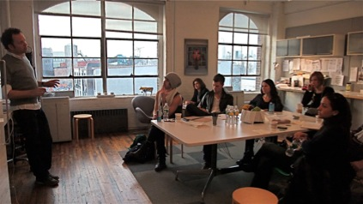



Life and Work in the 21st Century

Slide 4
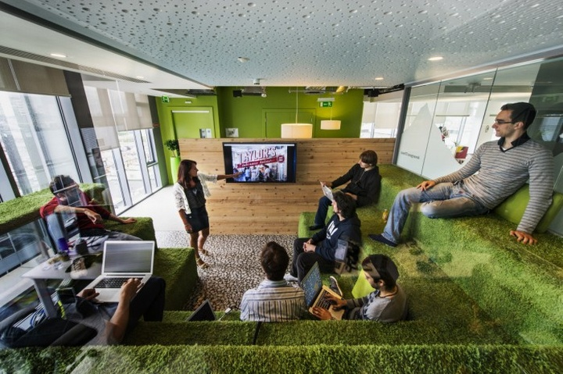
…at work, home, play, and in social action

Slide 5
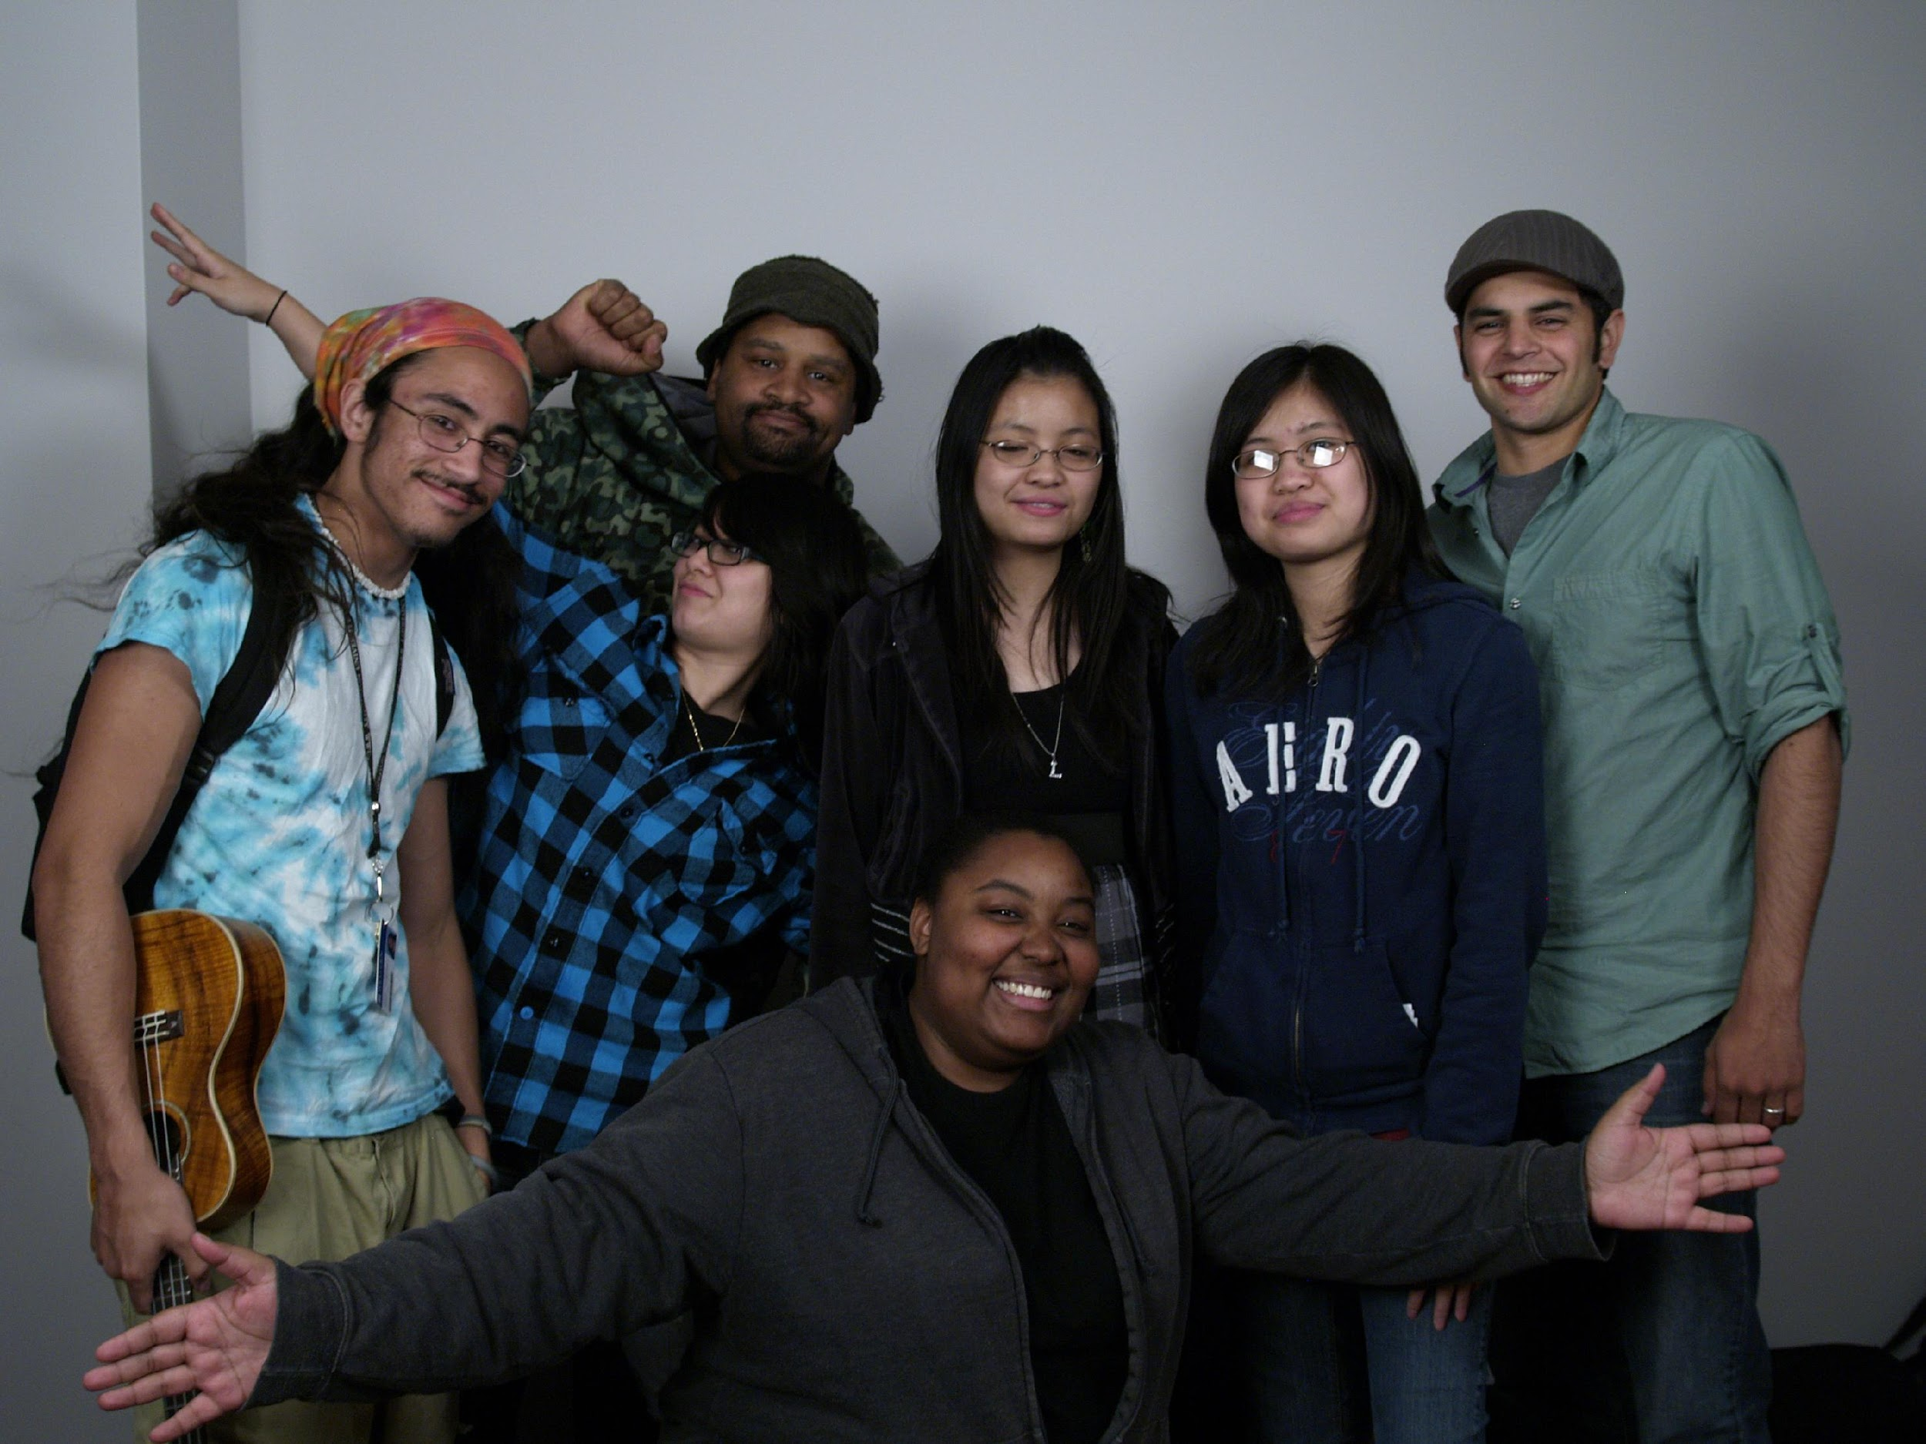
How do we increase students’ engagement?

Slide 6

How do we increase student confidence?

Slide 7

How do we keep it Digitally Relevant?

Slide 8
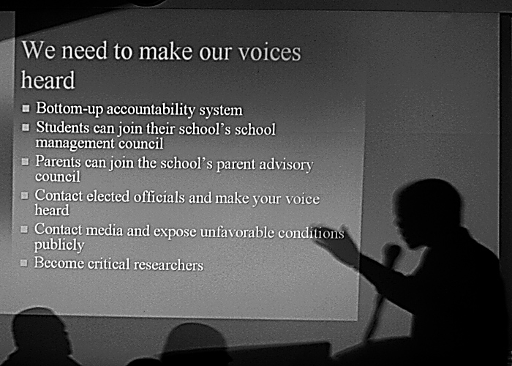
The Principles

Slide 9

Understanding Failure
Lack of Confidence
Lack of Relevance
Lack of Engagement with high quality relevant literature
Lack of engagement with a community of learners
Lack of engagement with the social world

Slide 10
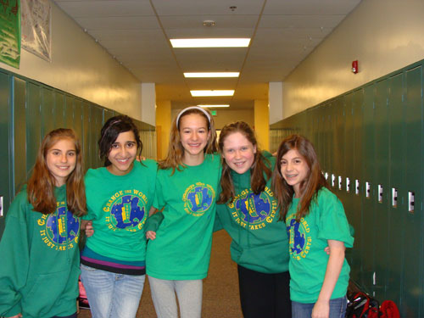
Cultivating Student Voices
Having something to say: (Motivation)
Knowing how to say it: (Literacy)
Feeling good about your ability to say it (Identity)
Saying it with authority and power: (Achievement)
Using voice to know myself and others: (Social Emotional Learning)
Working together for things that matter to us (Social Awareness)

Slide 11
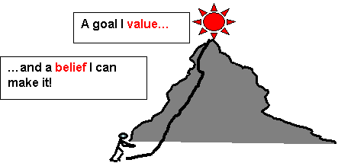



Inspiration, Engagement, & Achievement
The Expectancy-Value Theory of Motivation
+
=
Notes:
We have to begin our conversations with young people with the challenge of motivation.
Why is it that people are not motivated? And how do we motivate young people who may be (justifiably) concered about their chances to navigate an implicitly hostile educational system. Often this hostility is something they can sense, even though it is not always possible for them to put their finger on any specific incidents.
To understand the issue of adolescent motivation I began to consult psychology where I came across the expectancy-value theory of motivation, which really changed my life and my pedagogy.
Explain the slide
Transition: I will explain how, in my work I have tried to draw from this expectancy value theory to motivate young people to become better students and better advocates for change.

Slide 12
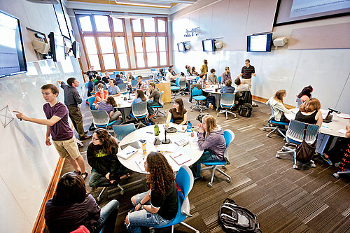
Promising Practices

Slide 13


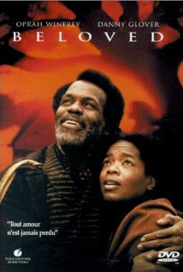
Globalizing Humanities Education

Slide 14
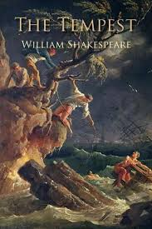
What do we mean by “Reading”?
What do we read?
How do we read?
What do we do while and after we read?
How have we decided throughout history what is good to read? How do we decide today?

Slide 15
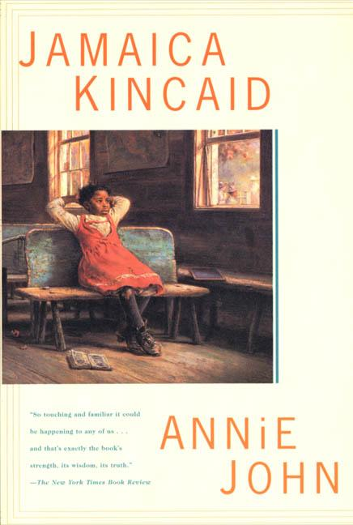

Different Reading. Reading Differently.

Slide 16
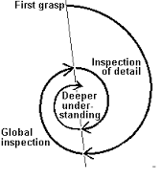
Theories of Reading
Reading Behind the Text
Reading Within the Text
Reading in Front of the Text
“The Hermeneutic Circle”

Slide 17
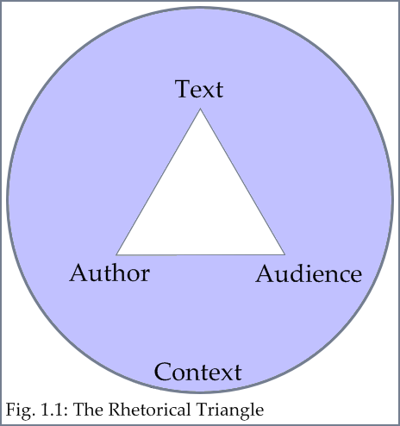
The Rhetorical Situation
Privileging the Author
Privileging the Reader
Privileging the Text

Slide 18

Critical Hermeneutics
Intersectional
Gender/Feminist
Racial/Postcolonial
Reader Response
Youth-Focused
Class/Marxist
Historical/Biographical
New Critical

Slide 19

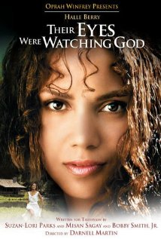
REEL Engagement
Incorporating Film Study into Literacy Units

Slide 20
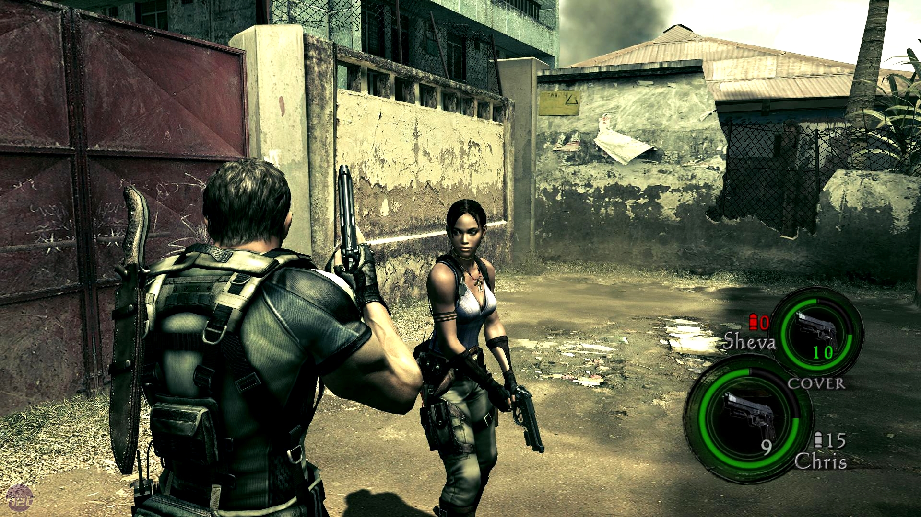
Literary Analyses of Videogames?
AA Criticism of Resident Evil 5 & King Solomon’s Mines

Slide 21
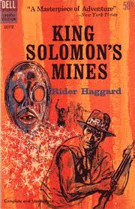
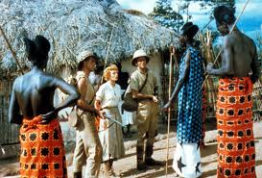
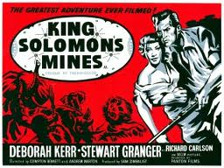

Slide 22
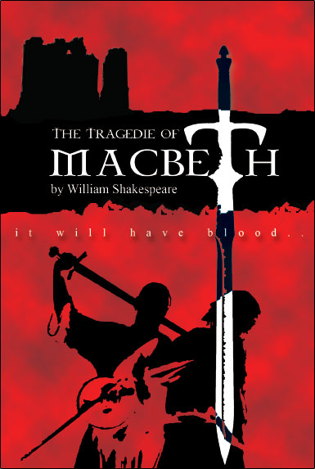
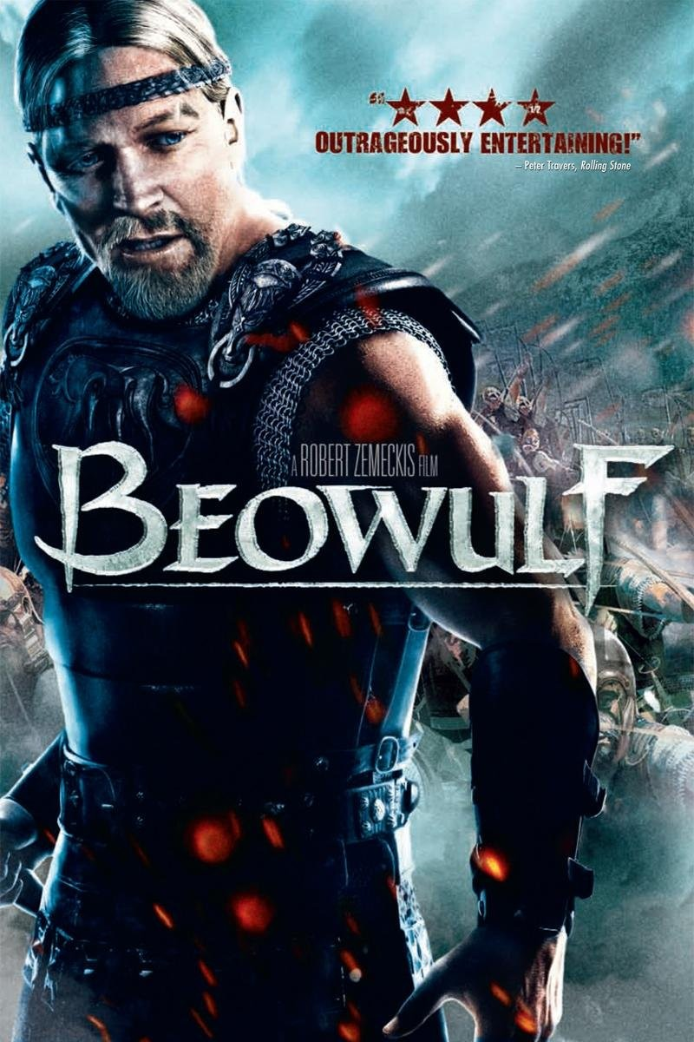
Translating MacBeth into “Hip Hop”?

Slide 23
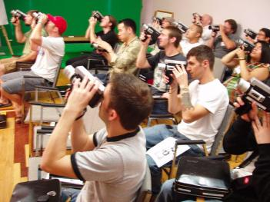
Writing in the Arts in the Digital Age

Slide 24
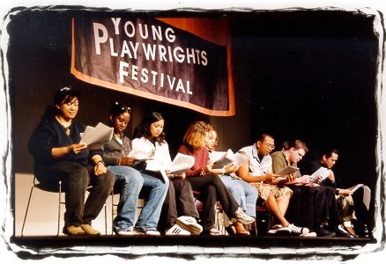
Students as Playwrights

Slide 25

Critical Hip Hop
Critical Hip hop as a youth-initiated critique of post-industrialism (Rose, 1994)
Critical Hip Hop as a Postcolonial Space (Fanon, 1961)
Critical Hip Hop as a voice of resistance (Chuck D, 1997; George, 1998)
Critical Hip-hop as pedagogy
Critical Hip-hop as social activism
Critical Hip-hop; Poetics, Pedagogy and Praxis.
Notes:
While the genesis of hip-hop (hip-hop’s roots) is critical, it is important to explicate the aspects of hip hop that make it critical, helps in selection of texts and artifacts that are worthy of pedagogy in a critical antiracist hip-hop pedagogy.

Slide 26
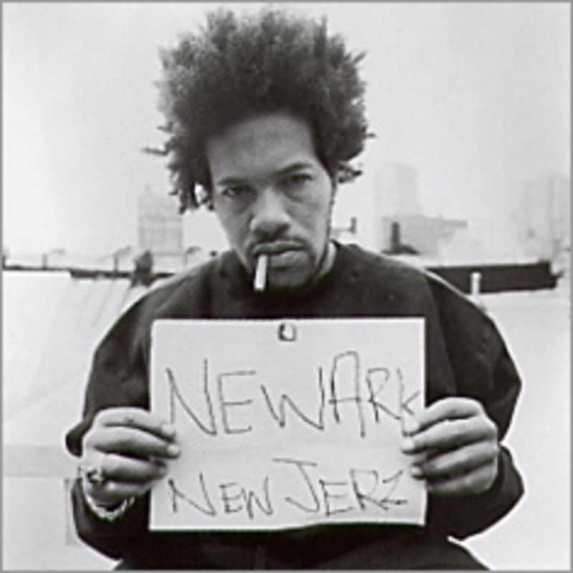
Hip Hop Literary and Cultural History

Slide 27
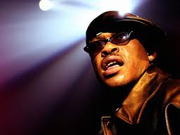
Hip-hop and anti-colonial consciousness
Now is the chance to advance and get an outlook Create the circumstance, because I doubt books can relay, words this way, so I'll portray a new image, and let's begin as members who pledge to, look up ahead to a beautiful world, though we've been led to believe it will not be and, we still are seein Agreein there'll be peace, the wealth will increase and we'll prosper, you know like flourishin The rhyme I toss ya, it will be nourisihin Cause I must bring, ideals for better living see Because I do believe in positivity--GURU

Slide 28
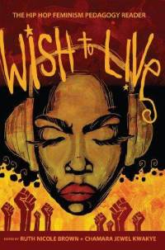
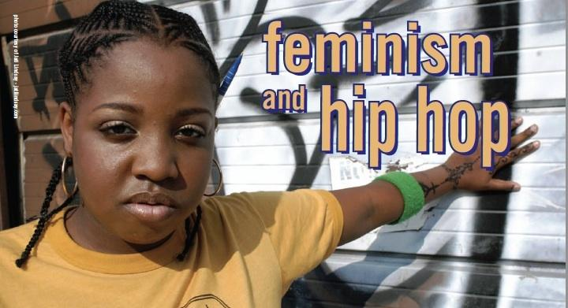
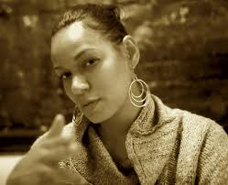
HIP HOP Feminisms

Slide 29
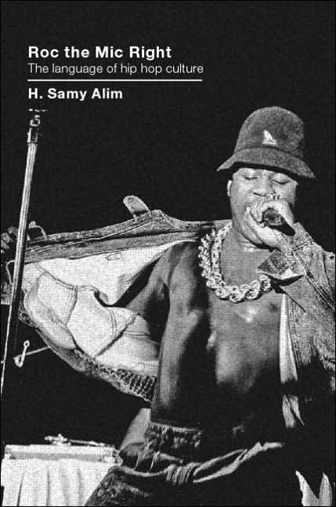
The Rhetoric of Hip Hop
"A pedagogy is successful only if it makes knowledge or skill achievable while at the same time allowing students to maintain their own sense of identity.”—Keith Gilyard
Rhetorical Study of Hip-Hop
Student rhetorically analyzes author’s purpose, intended audience, and goals.
Student interprets, analyzes, and critiques author’s use of literary and rhetorical devices, language, and style.

Slide 30


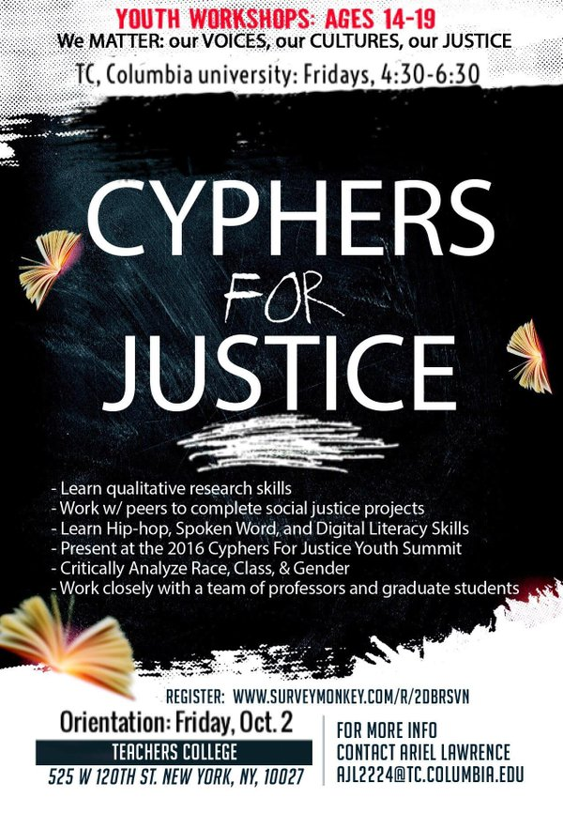
Cyphers for Justice

Slide 31
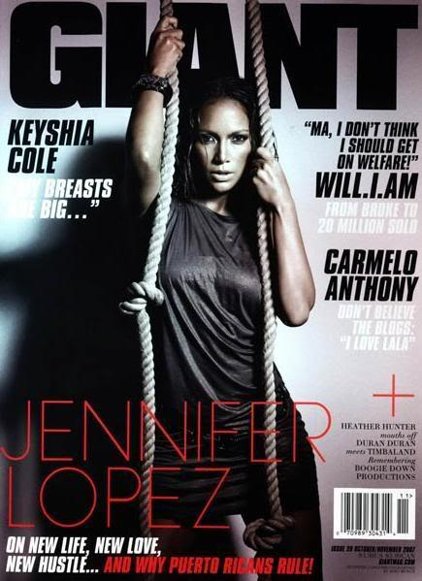
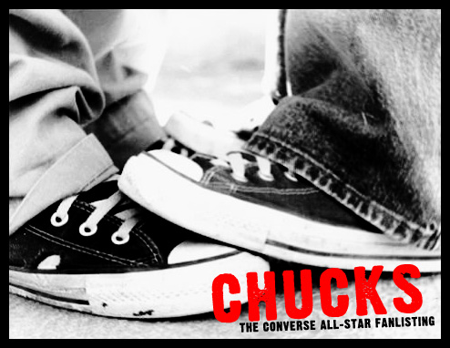
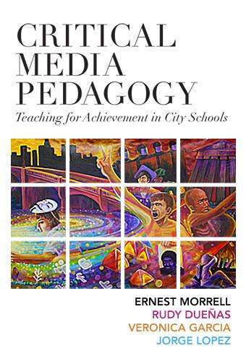

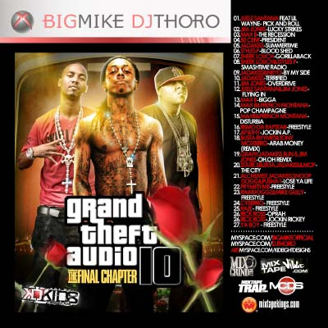

Slide 32
Critical Media Analysis
Reading the Media through a Critical Lens
What values or ideas are promoted?
  What does it mean to be normal (or cool)?
  What does it mean to have power?
  What does it mean to be desired?
  Who is marginalized or “Othered”?
How is the audience/recipient constructed?
  Who is targeted?
  What assumptions are made about the audience?
  How does the ad/image/artifact intend to make the recipient feel about him or herself?
  What is an audience member compelled to do/believe?

Slide 33

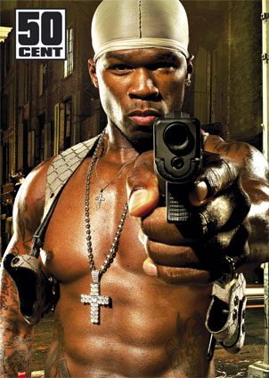

Slide 34
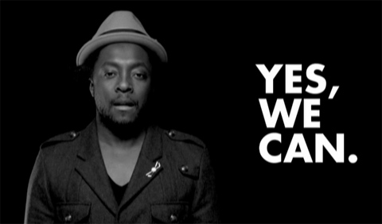
Media and youth social movements

Slide 35
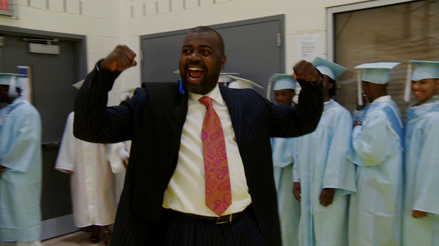
Powerful Literacy in the Social Sciences

Slide 36

Filmmaking as Social Action
The One-Minute PSA Contest
Involves background Research (Reading)
Requires Academic Writing
Uses Cheap and Accessible Technologies (Phones, Tablets)
Fun and Engaging
Serves Social Purpose

Slide 37
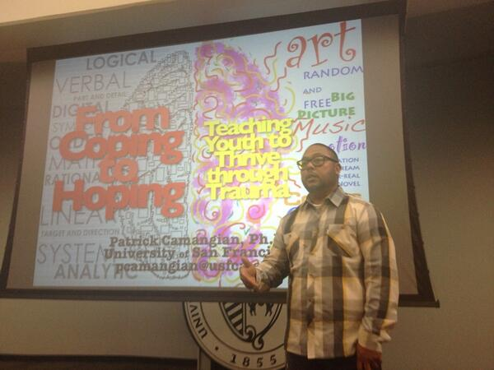
Auto-ethnography Project
My Self
  Poetry, Narrative Writing, Scripts
My Community
  Journalistic, Case Study
  Interviews, observation
My World
  Quantitative, descriptive statistics
  Demographics

Slide 38
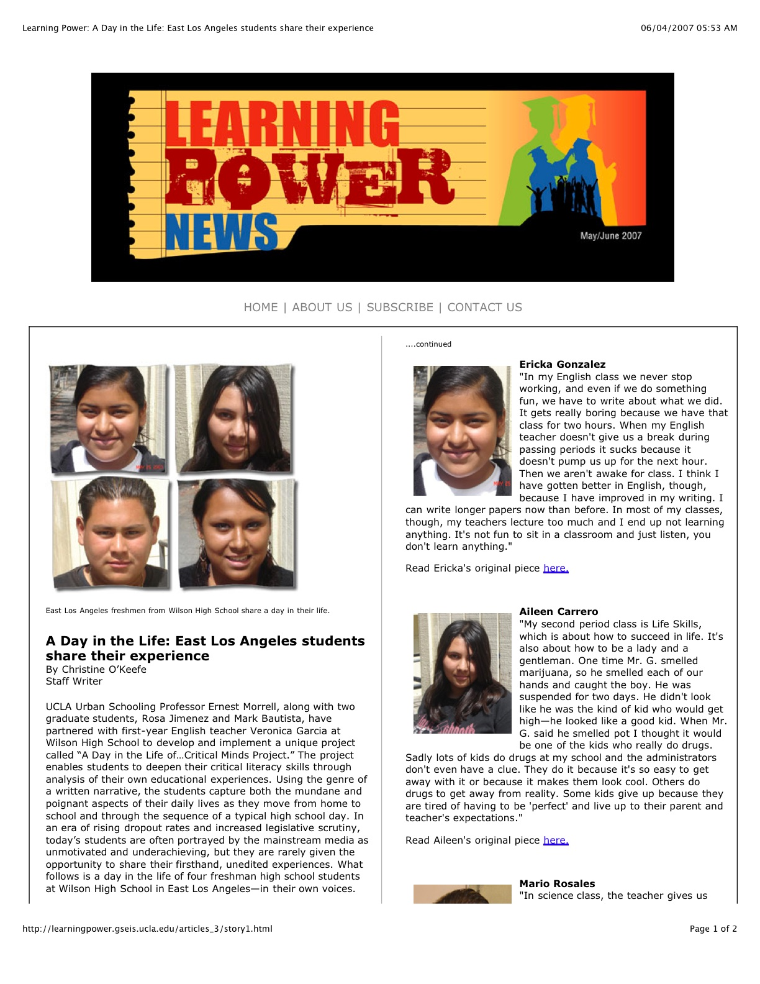
A Day in My Life…

Slide 39
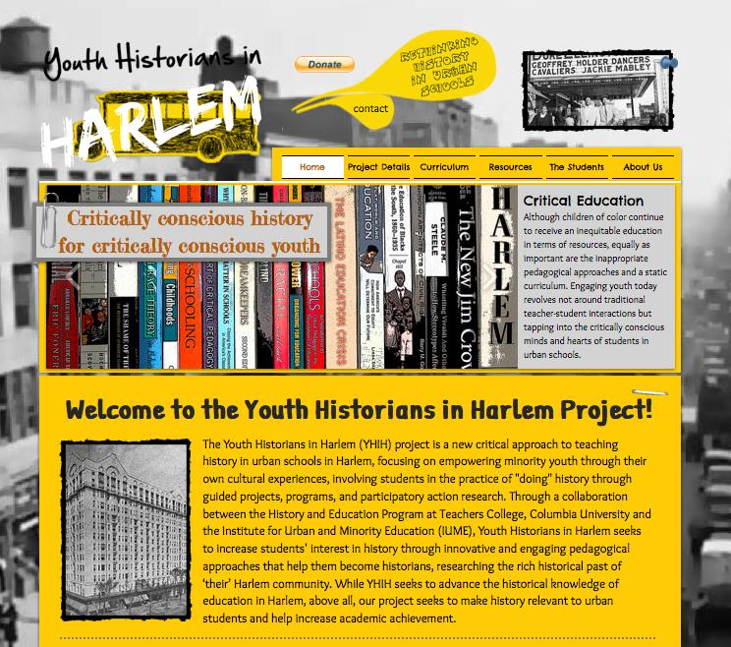
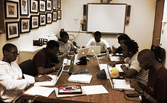
Becoming Digital Archivists

Slide 40

Oral History Projects

Slide 41

Bless Me Ultima—Oral History Project
Length: 5 weeks
Culminating Task:
  Oral History Essay
  Power Point (5 Slides)
Resources:
  Bless Me Ultima by Rudolfo Anaya
  Computers
Essential Questions:
What forces influence our identities as young people? Am vs. Latino
How do we as young people deal with DUALITY (two kinds of “worlds”)—living in a US society (new ways/modern) while still maintaining the language, traditions, and values of our home culture?
What knowledge and history of our past (from our elders) can help inform/guide us towards our future?
What connections or shared experiences do we share with Antonio and his family’s experiences and our own? Why?

Slide 42
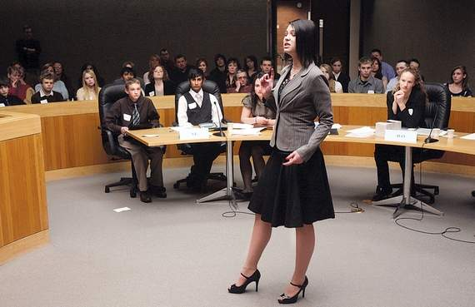
Mock Trials, Debate, and Legal Research

Slide 43

Mock Trials in the Humanities Classroom
“Putting Bigger Thomas on Trial”
The Casebooks
All the questions prepared for the witnesses of your team and scripted responses
All of the anticipated questions to be asked of your witnesses in cross-examination.
All of the questions prepared in advance for opposing witnesses in cross-examination.
The opening arguments.
All notes taken during the trial (trial notes are mandatory)
A 5-7 page summation/analysis of the trial.

Slide 44
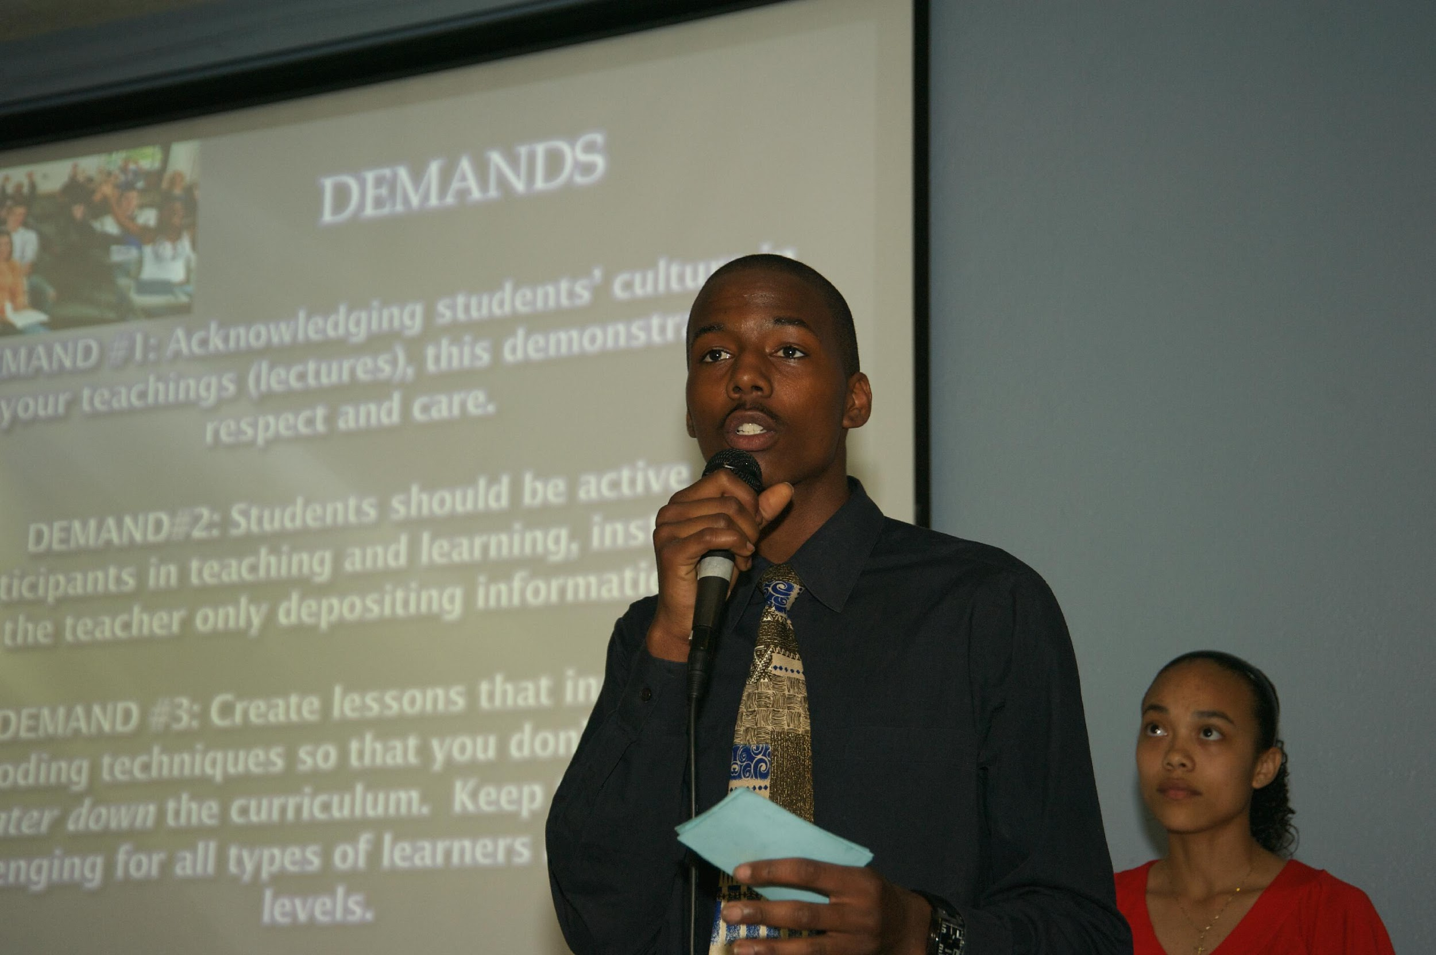
Student Research and Social Action Projects
If you could change the world what is one thing you would do?
If you could change your community what is one thing you would change?

Slide 45
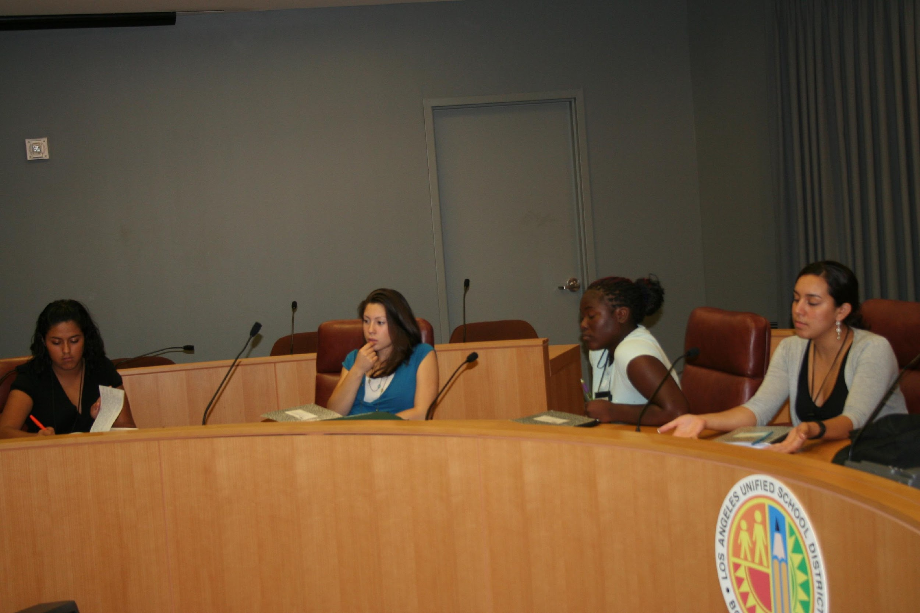
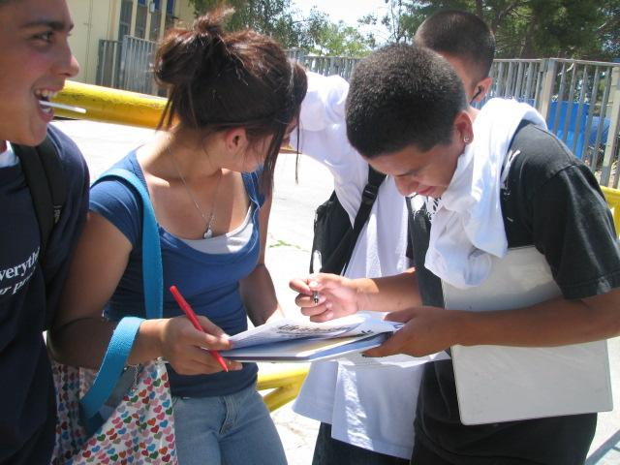
The Process
  Identify a problem
  Develop a Question
  Design a study
  Collect data
  Analyze Data
  Make Claims
  Provide Evidence
  Create Products
  Disseminate Products
  Social Action
Notes:
The work is not part of a field trip to the local schools and communities and while the process is intended to develop individual literacy skills and facilitate personal transformations, its also important for us that the student research be legitimate and make legitimate contributions to the project of educational and social justice. The students have generated work that has made a difference in the issues that matter most to them, their peers, and their communities. [IN THE CHAPTER I CAN PULL OUT EXAMPLES THAT FLESH OUT EACH OF THE BULLET POINTS LISTED ABOVE]
We must realize that youth have to become important co-participants, its important to their pedagogy and its important to move toward the outcomes we want in urban education.

Slide 46
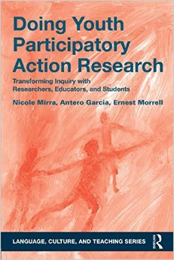
Youth Participatory Action Research (YPAR)
Involves young people as researchers and change agents (Who/What)
Research is community-centered (Where)
Collective investigation of problems (How)
Connects Research to Social Action (Why)

Slide 47
Inequality of Education
Historically and currently,
South Central Los Angeles schools have lacked the necessary resources needed to provide a quality and effective education
  “Despite greater need, 79% of large city districts studied by the Council of Greater City Schools are funded at a lower rate than are suburban schools; nationally, advantaged suburban schools spend as much as ten times that spent by urban poor schools”
  (Anyon 1997)
Notes:
The economic crisis in the community also has an impact on school which leads us to our second claim. (State claim)
According to Anyon even with the greater needs of urban poor schools they are still being funded at a lower rate then most of suburban schools.

Slide 49

Graduation Rates &
A-G Requirements
Median household
income:
Palo Alto –
$90,377
South Central L.A. –
$34,069
93%
65%
39%
20%
California Educational Opportunity Report
UCLA/IDEA 2007
Notes:
These low resources have a significant impact. when compared to other districts LAUSD students perform at a significantly lower rate
Take for example in 2007 the palo alto district which has a median household income of 90,377 as compared to the median household income of 34,069 in south Central L.A. - the graduation for palo alto is 93% when Lausd ‘s 39% isn’t even half of their graduation rates and when it comes to students graduating with a-g requirements palo alto’s rate is 65% which is more then half of its graduated students and three time more than lausd’s rate which is 20%

Slide 50


Demands
Step Into Our Shoes
Radical Truth-Telling
Notes:
Greg

Slide 51


Action Plan for Families
Students: Learn about your school-site council (become a student representative and share the information you learn with others)
Parents: Educate yourself about the platforms of politicians running for office in 2010 (VOTE or encourage others to exercise their right to vote)

Slide 52


Action Plan for Community Leaders
Policy-makers: Streamline communication between school district and city officials to develop a comprehensive plan to help homeless youth and families.
Teachers: Create lessons that connect your subject to the economic crisis (organize student focus groups)
Notes:
Emily and erick

Slide 53


Having a positive rather than deficit model
Meaningful engagement in the math classroom
Connecting math to community engagement
Collaborative inquiry with teachers

Slide 54

Critical Quantitative Research
Improving Mathematical Reasoning through Social Action
Quantitative Data:
  152 Crenshaw surveys ; 31 VIPS surveys
  Drop out/ Push out rates
  Grade distribution
  Exam data -test scores
  Staffing data
  Student demographics
Sources: CBEDS
Notes:
To study the problem of disengagement in schools, we did critical research. What we mean by critical research is that we did research in the favor of the community, who have less power. Although we are high school students we are capable of doing research at a college graduate level.
What we’re interested in is the change that might happen if the power is given to the people. This research is also critical because we didn’t do this research for fun. We used our time to do this research, not only for us, but for everyone because it shows that there are people, students, and kids that need to know the truth. What makes our work different from any other research is that we are studying the problem we live in.
We collected both quantitative and qualitative data. Quantitative looks for amounts while qualitative studies the conditions, closely.
For quantitative data, we collected 183 total surveys, looked at achievement data, student demographics and more.
For official school data, we used dataquest, which is the California Basic Educational Data System’s website

Slide 55

South Central L.A. High Schools
66%
38%
25%
22%
16%
13%
California Educational Opportunity Report
UCLA/IDEA 2007
Notes:
In addition when we compare two schools located in south central to the states graduation rate, there is a substantial difference. The state’s graduation rate and fulfillment of a-g requirements are 66% and 25% respectively, compared to 38% and 16% for Manual Arts High School and 22% and 13% respectively at Crenshaw High School.

Slide 56


I trust the government to help my community with the crisis.
At Manual Arts
At Crenshaw
Notes:
Because the cycle of oppression students in both crenshaw and manual arts show that they have little trust in the government to help change their conditions

Slide 57

I believe my school is making the
right decisions for my peers and me
about the budget crisis.
Manual Arts
Notes:
Similarly when students at manual arts were asked they said that they don’t feel that their school is making the right decisions concerning the economic crisis.

Slide 58

Notes:
If you look at the slide here, brown represents whites, blue represents African-Americans, Red are Latinos, and green is for Asians. The darker the color, the higher the concentration. In this slide you notice that LA was mostly white in the 1960’s…

Slide 59

Notes:
In the 70’s Whites began to leave, while Blacks moved west and their pop.ulation grew, as did the Latinos, slightly

Slide 60

Notes:
In the 80’s, the Latino population grew noticably in LA, while the white population decreases and African Americans are predominant in more areas of the city. Also some majority Asian populatinos appear

Slide 61

Notes:
In the 90’s, African-Americans begin to move from the city, as whites continue to as well. Latinos are getting bigger and they begin to spread out.

Slide 62

Notes:
In 2000, Latinos are the city majority, and African Americans seem to have moved from LA… Crenshaw HS is in one of the last Black communities of LA.

Slide 63

Science Rap Battles

Slide 64

Science Genius Project

Slide 65

Science Genius & #HipHopEd

Slide 66
Science Genius
B.A.T.T.L.E.S. (Bringing Attention to Transforming, Teaching and Learning Science) was conceived as a way to keep students engaged in school and in science. The contest is the brainchild of GZA, Christopher Emdin, Assistant Professor of Science Education at Teachers College; and Rap Genius, a website where rap is posted, critiqued as poetry and annotated. GZA and Jeremy Dean of Rap Genius were among the six judges who watched as teens ages 14 to 20 strode the stage at TC’s Joyce B. Cowin Conference Center and “spat” lyrics that ran a gamut of topics from rock science, natural selection and genetics to how materials freeze or melt. The raps were judged on the quality of their scientific content as well as their lyricism and beat.

Slide 67

Becoming Digital Inventors…
#YesWeCode

Slide 68


Slide 69

#YesWeCode

Slide 70

Digitally Relevant Pedagogy
Digital Consumption Understanding of the role of media in perpetuating cultural hegemony
Digital Production. Becoming skillful and willful producers and curators of digital content
Digital Distribution. Willingness and ability to distribute digital content.
Digital Invention. Students become creators of apps, tools, etc.

Slide 71

How Gaming Can Make a Better World?
Jane McGonigal

Slide 72

Video Game Class?

Slide 73


“There is absolutely no inevitability as long as there is a willingness to contemplate what is happening.”-Marshall McLuhan
ernestmorrell@gmail.com
Notes:
In one of my favorite quotes, noted Canadian media theorist Marshal McLuhan claims that, “Nothing is inevitable as long as there is a willingness to contemplate what is happening. I admire this quotation both for its optimisim, but also for its process. First and foremost we must understand that any reading of history shows us that the only constant is change; and any reading of the history of social movements shows us that people have continually overcome greater obstacles than those we currently face in literacy education. Second, we must think about our process of change. McLuhan recommends contemplation, a word with many layers of meaning and connotation. It primarily means to think deeply and to be aware of one’s own thinking. In this book we have thought deeply about the histories of literacy education and critical thought and their bearing on our current challenges in literacy instruction. Contemplation also means being “in” and “with” time. In other words, if we contemplate we are also forced to think about our moment; to consider what needs change and how we, as everyday citizens, as teachers, as public intellectuals, and as agents can change it. I have also in this talk tried to include myriad examples of the ways that educators can work with urban youth in our time to develop academic and critical literacies. Contemplation is important because it forces us to think carefully about our conditions and then to think deeply about alternatives to those conditions. Once we imagine alternatives, we begin to understand the possibilities for transformation; for making the world anew, even if in our cases we are talking about the world of the classroom. That is a large enough goal, which will ultimately have a large impact on the remaking of the world. Contemplation, our collective contemplation, can make these things happen. I am also reminded by the words of another important scholar of a bygone era; Paulo Freire contends that to imagine new ways of being is to already begin to act differently upon the world. In other words we must not only contemplate, we must act. That is our only and best hope.

