Slide 1
Does Fairness Matter? Giving All College Students a Fair Shake
Panelists
Meegan Dugan Bassett, State Policy Consultant
Amelia Noel-Elkins, Director, University College
Jonathan Rosenthal, Associate Vice President
Levester Johnson, Vice President, Student Affairs
Lisa Castillo Richmond, Managing Director, Partnership for College Completion
Moderator: Dr. Jim Applegate, Visiting Professor, ISU

Slide 2
How Are We Doing? Making Progress but Still Work to Do
Retention and Graduation Rate Trends

Slide 3
ISU: Strength, Progress, and Opportunity
IBHE Data provided 1/4/18
Notes:
2015 20 pt. gap! (though way above peers on total and slightly URM)
2016 huge gap closure (13 points) now way above peers on both
BUT STILL 8%

Slide 4
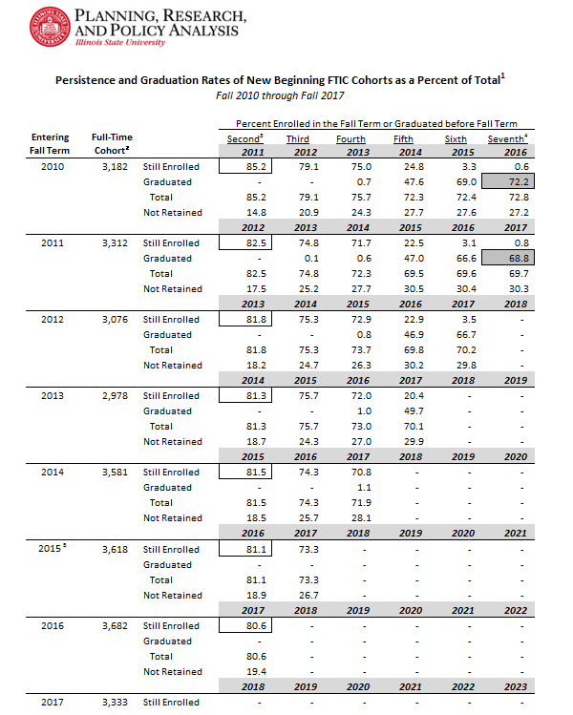
Reaching our Goals – In Retention

Slide 5
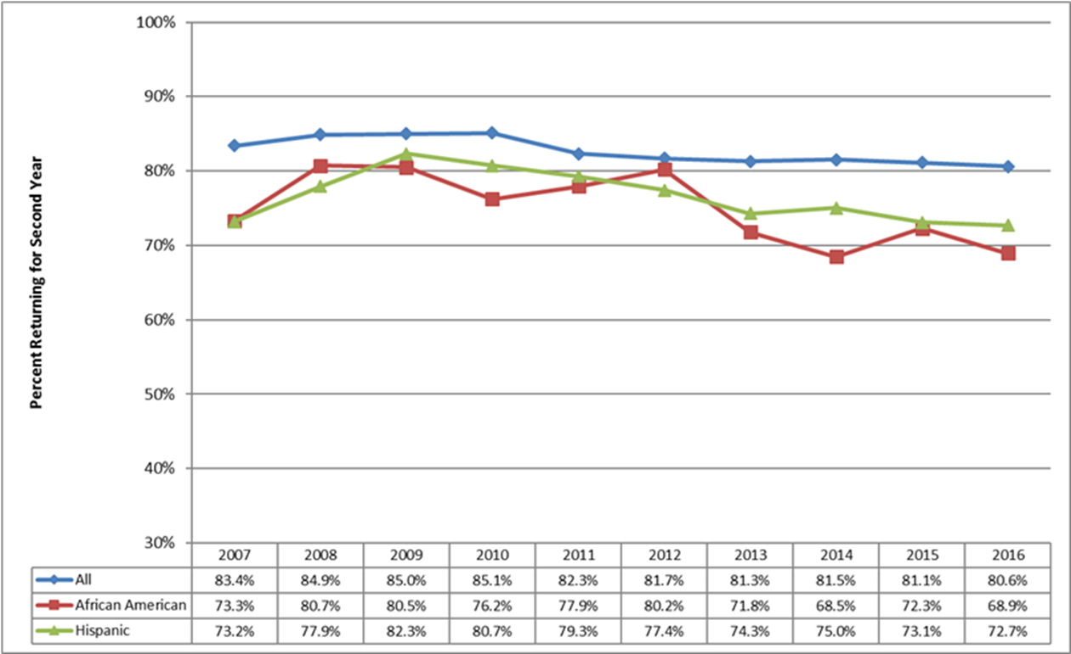
Reaching Our Goals – In Retention

Slide 6
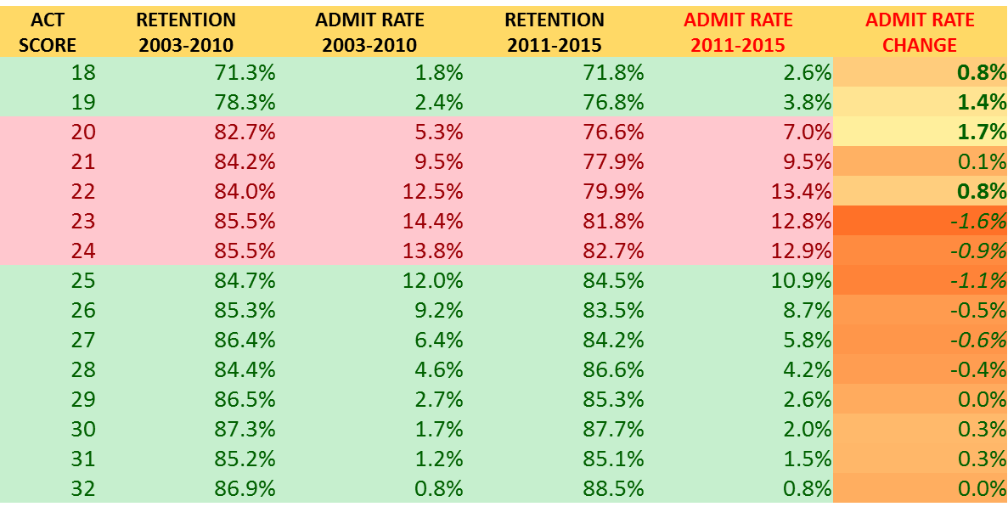
Reaching our goals – in retention

Slide 7
What Are Our Fairness Challenges?

Slide 8
What Do We Do To Give ALL Students a Fair Shake?

