Slide 1

International Pathway Partnership
INTO Illinois State University

Slide 2
Foundation for International Enrollment
Enhance diversity, extend global learning, and further develop global campus environment
Goal to increase international enrollment to 10% of total enrollment within 10 years.
Current international enrollment is 2%.
Adding international students help address decline in high school graduates in Illinois and Midwest

Slide 3
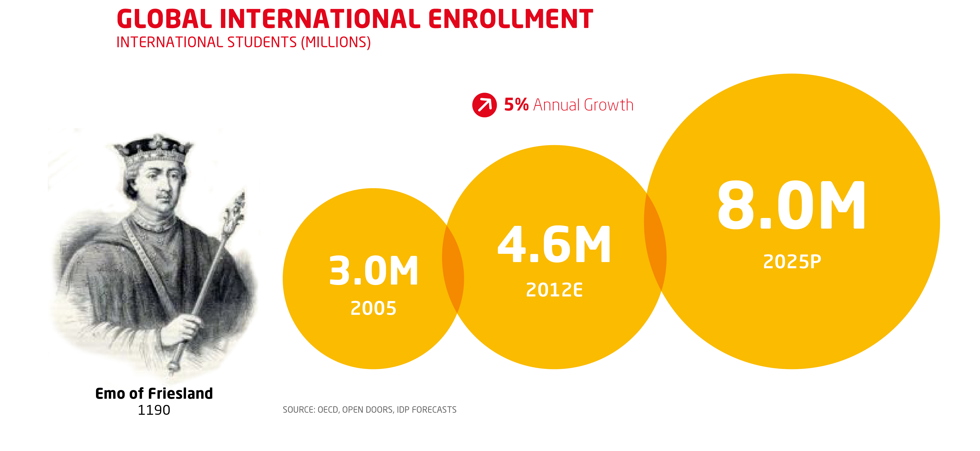
The number of international students is forecast to double by 2025, creating a big opportunity for universities

Slide 4
ISU Far Behind State and National Rates

Slide 5
Joint Venture:
Partnering with INTO
INTO is global leader in international student recruitment and pathway programs.
$66m investment in marketing universities globally
Marketing campaign in 19 languages aimed at > 130 countries
Extensive partnerships with agents (over 900) and institutions (~700) around the world
Data analytics on international recruitment

Slide 6











INTO Joint Ventures in U.S

Slide 7

An INTO partnership gives universities academic control, but brings capital, global reach & track record
Inputs
Start Up capital
Global reach
Recruitment and marketing know how
Application processing
International student experience
Inputs
Academic control – entry and exit requirements and academic coursework
Provision of campus services
Health, dining and residence services
University returns
International student enrollment growth
Stronger student outcomes and experiences
Substantial increase in mission-enabling revenues
Academic control
Positive community impact
Programs
Pathway and English teaching
Assured progression
Globalized campus experience
Specialized preparation
On-campus facilities
Strong student outcomes

Slide 8
What INTO Brings to the Partnership
Start up capital
Global outreach
Recruitment and marketing know how
Application processing
International student experience

Slide 9
Illinois State University’s Contributions
Academic reputation
Quality academic programs
Experienced faculty
Control of all academic related matters
Facilities and services

Slide 10
Joint Venture
  Academic English instruction using ISU faculty
  Pathway Programs
  Preparation for regular admission to degree programs
  Strong academic student outcomes
  Student support

Slide 12
Undergraduate Pathways
Direct Entry
GPA 2.8
TOEFL 79
IELTS 6.5
Standard courses; direct matriculation
Accelerated Pathway
(1 semester)
GPA 2.25
TOEFL 79
IELTS 6.5
1 semester ELI (Academic ENG, 3 hrs)
6-9 hours courses
Standard Pathway
(2 semesters)
GPA 2.25
TOEFL 65
IELTS 5.5
2 semester ELI (Academic ENG, 6 hrs)
6-9 hours courses
Progression requirements for matriculation
GPA 3.0
B or better
No I or WX
Standard courses

Slide 13
Undergraduate Pathways
In all majors except for Nursing.
Majors are “bundled” in five areas each with 1, 2, or 3 semester pathways:
  Business
  Science, Applied Sciences & Technology
  Computer Science
  Computer Science: Information Science
  Liberal and Fine Arts

Slide 14
How were the pathways developed?
Students are placed by level of English proficiency
Students are placed by intended major
Pathway groups were built by common first-year requirements.

Slide 15
For example…
Computer Science Information Systems:
Cybersecurity
Information Systems-Integration of Enterprise Systems
Information Systems-Systems Development/ Analyst
Information Systems-Web Application Development
Network and Telecommunications Management

Slide 16
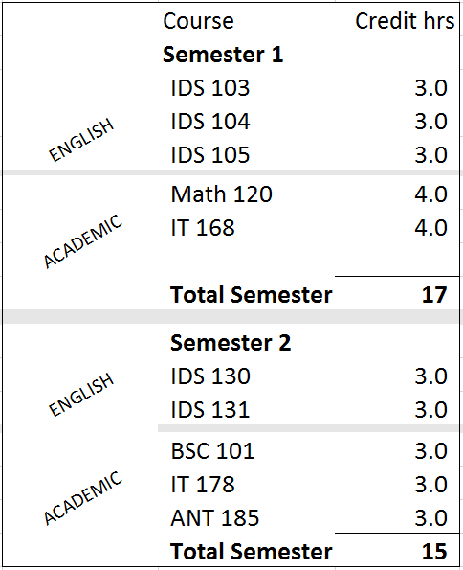
For example…
Computer Science Information Systems:
Two semester Pathway
No change to degree requirements
No change to major requirements
English courses (like advanced foreign language courses) may count toward the 120 total hours for the B.S. degree.

Slide 17
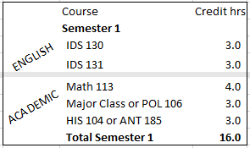
For example…
Liberal and Fine Arts:
One semester pathway
Most non-STEM majors in CAS and CFA. Some majors in CAST that don’t require specific math and science courses.

Slide 18
Graduate Pathways
Direct Entry
GPA 2.8/3.0
TOEFL 79
IELTS 6.5
Standard courses; direct matriculation
Accelerated Pathway
(1 semester)
GPA 2.5
TOEFL 79
IELTS 6.5
1 semester ELI (Academic ENG, 3 hrs)
6-9 hours courses
Standard Pathway
(2 semesters)
GPA 2.5
TOEFL 65
IELTS 5.5
2 semester ELI (Academic ENG, 6 hrs)
6-9 hours courses
GPA/TOEFL minimums exclude MBA, ACC, IT
Progression requirements for matriculation
GPA 3.0
B or better
No I or WX
Standard courses

Slide 19
Graduate Academic Pathways
Business
  MBA
  Accounting
  Information Systems
Fine Arts
  Arts Technology
  Costume Design
  Music Performance
  MFA Studio
Arts and Sciences
  Math (Stats, general, Biomath)
  Economics
  Hydrogeology
Applied Science & Technology
  Technology
  Family and Consumer Sciences
  Kinesiology & Recreation (Ex Phys, Biomechanics)
  Information Technology

Slide 20
Example – 1 & 2 Semester Graduate Pathway
FINE ARTS (Music Performance)
Total Credits Required for Degree |  | 34-36
Total PW Earned Credits |  | 13
Total PW Credits Toward Degree |  | 7
 | Semester 1
ACADEMIC ENGLISH | IDS 401 | 3
 | IDS 431 | 3
MAJOR COURSES | MUS 431 | 3
 | MUS439 | 1
 | MUS 300 level Styles or Genres | 3
 | Total Semester 1 | 13
FINE ARTS (Music Performance)
Total Credits Required for Degree |  | 34-36
Total PW Earned Credits |  | 29
Total PW Credits Toward Degree |  | 14
 | Semester 1
ACADEMIC ENGLISH | IDS 403 | 3
 | IDS 404 | 3
 | IDS 405 | 3
MAJOR COURSES | MUS 431 | 3
 | MUS439 | 1
 | MUS 300 level Styles or Genres | 3
 | Total Semester 1 | 16
 | Semester 2
ACADEMIC ENGLISH | IDS 401 | 3
 | IDS 431 | 3
MAJOR COURSES | MUS 431 | 3
 | MUS439 | 1
 | MUS 300 level Styles or Genres | 3
 | Total Semester 2 | 13

Slide 21
Questions?

Slide 22
International Enrollment Trends
YEAR | 2012 | 2013 | 2014 | 2015 | 2016 | 2017
Total Enrollment | 20,502 | 19,924 | 20,615 | 20,807 | 21,039 | 20,784
Total International | 382 | 400 | 425 | 376 | 376 | 387
International Undergraduate | 149 | 131 | 139 | 117 | 111 | 119
International Graduate | 233 | 269 | 286 | 259 | 265 | 268
New International | 105 | 104 | 117 | 118 | 140 | 147
Percentage of Total Enrollment | 1.9% | 2.0% | 2.0% | 1.8% | 1.7% | 1.9%

Slide 23
International Student by Type

Slide 24
Top Countries for International Students

Slide 25
Top Academic Fields for Internationals

