Slide 1
Encouraging Literacy Through Course Design: A Multidisciplinary Approach
Erika Rosenberger, Britni Williams, Rachel Sparks
Illinois State University
Teaching and Learning Symposium 2018

Slide 2
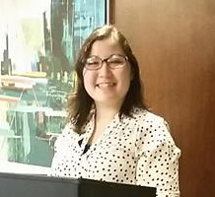

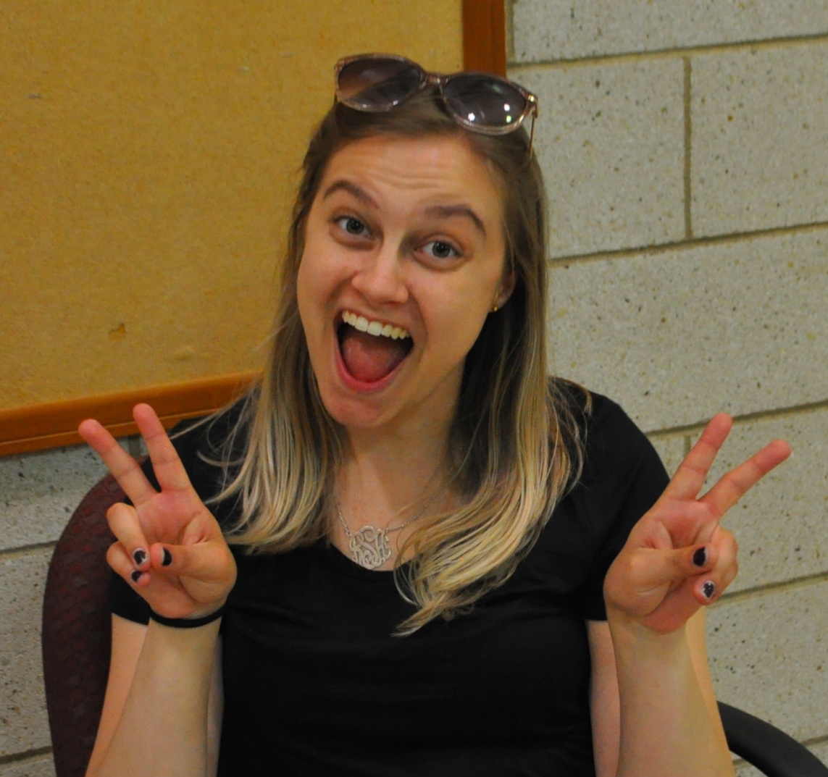
Erika Rosenberger
Britni Williams
Rachel Sparks
M.S. candidate, Psychology
Graduate Teaching Assistant
B.S. in Psychology, University of Illinois Urbana-Champaign
Research Interests: gender, culture, stigma, feminism, media, etc.
Goals: community college instructor
PhD student, English Studies
Graduate Teaching Assistant, Instructor of Record
M.A. in English, University of Akron
B.A. in English, Kent State University
B.S. in Journalism, Kent State University
Research Interests: YA literature, ecocriticism, posthumanism
PhD candidate, Biological Sciences
BSC 101 lecture instructor
B.S. in science education from Miami University (Oxford, Ohio)
Former high school science teacher
Research Interest: role of instruction in combating science denial, increasing scientific literacy, and improving understanding of evolution
Notes:
Britni, you’re gonna talk about IDFF here :)
Cool beans, I’m assuming the short 2 minutes or less version, right? -B
Yep! -R

Slide 3

Outline
Encouraging literacy
Modification in the classroom
Scientific literacy

Slide 4
Outline
Encouraging literacy
Modification in the classroom
Scientific literacy

Slide 5
Encouraging Literacy
What is Literacy and why do we care?
What is Backward Course Design?
Integrating Literacy

Slide 6
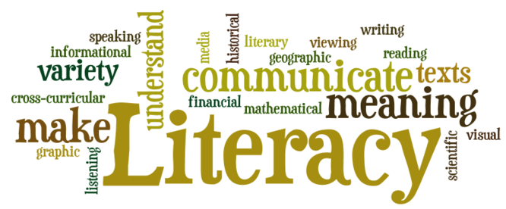
What is literacy?
Vary depending on particular context (Lea, 2004)
Information literacy
  “...set of skills required to identify information sources, access information, evaluate it, and use it effectively, efficiently, and ethically” (Julien & Barker, 2008)
Integrate into our courses
Notes:
The theme of the current symposium is about expanding literacy. Before discussing how this can be accomplished through our classrooms, I would like to define the term. As it is used commonly, literacy can refer to an individual’s ability to read and write. This can be addressed by requiring students to read their textbooks and write papers. However, literacy is not only the ability for one to read and write. It can vary depending on the context. For instance, psychological literacy is different from literacy in English or Biology. One form of literacy that can span multiple disciplines is information literacy. Julien and Baker defined Information literacy as the set of skills required to identify information sources, access information, evaluate it, and use it effectively, efficiently, and ethically. In other words, it is the ability to apply information to meet personal, societal, and professional needs and expectations. Of course, such information can be obtained from our courses. Ways to implement such literacy may be more difficult than simply having students read and write more during class.

Slide 7
Why do we care about encouraging literacy?
Students are lacking in literacy skills (e.g. Branch, 2003)
  High school students look for the “right” answer (Heinström, 2006)
  Undergraduates prioritize convenience (Urquhart & Rowley, 2007)
Better literacy skills are related to increased success in the workplace (Bloom et al., 1997)
Notes:
Why is it that the theme of the symposium is expanding literacy? Why should we try to encourage literacy through our courses? Much of the past research indicates that students tend to lack literacy skills, such as the ability to search for sources in an efficient manner and to evaluate the level of credibility of a reference. For example, Heinstrom discovered that high school students tended to simply look for the answer instead of looking into the quality of the source. Unfortunately, the lack of literacy skills seem to carry on into college. Researchers have found that undergraduates also prioritize convenience and their search skills were unsophisticated. This is alarming because studies have shown that literacy skills are related to positive outcomes. For example, economically, it has been found that better literacy skills are related to increased success in the workplace. Therefore, it is crucial for literacy to be addressed throughout students’ college careers. One way in which instructors can integrate literacy into their course is by using backward course design.

Slide 8
Backward Course Design (Wiggins & Tighe, 1998)
“...the approach to designing a curriculum or unit that begins with the end in mind and designs toward that end” (Wiggins & Tighe, 2005, p. 338)
Stage 1
Stage 2
Stage 3
Identify Desired Results
Determine Methods of Assessment
Plan Instructional Activities
1
2
3
Notes:
Traditionally, many teachers use a teaching-centered teaching format. With this format, instructors create lectures and activities that fit the number of credits and the allotted class time, making exams from the content covered in those lectures. It is teaching-centered because this method focuses on the content of what the instructor is teaching instead of if and how the students are learning. According to Wiggins and Tighe, backward course design is “the approach to designing a curriculum or unit that begins with the end in mind and designs toward that end”. Backward course design, contrary to the traditional methods, offers a learning-centered teaching format. Past research by Harper and colleagues in 2012 has found that students taught using a learning-centered method were found to focus on learning more than grades and felt more positively about their learning environment. Because backward course design focuses on the students, it will allow instructors to ensure that students’ literacy is improving from the present course. The backward course design consists of 3 stages. [Read off the stages.]

Slide 9
Backward Course Design: Stage 1
Identify the Desired Results
  Transformational Goal
    How do we want to transform our students?
  Learning Outcomes
    What do we want them to learn?
Worth being familiar with
Important to know and do
Enduring
Understanding
Notes:
In stage 1, the transformational goal and learning outcomes are identified. The transformational goal answers the question “How do we want to transform our students? What kind of person do we want the students to be after the class?” The transformational goal includes information about the ideas and concepts that the instructor would want the students to retain. After the transformational goal, the learning outcomes are identified. The learning outcomes should relate back to the transformational goal. It consists of enduring understanding of certain concepts that you want students to take away from the course, important knowledge and skills you want them to retain, and information that students are worth being familiar with. “What do we want the students to learn?” Once the desired results are identified, ways to assess whether the goals are being met are determined.

Slide 10
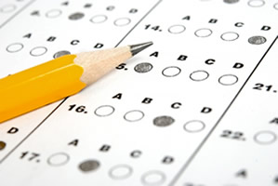
Backward Course Design: Stage 2
Determine Methods of Assessment
  How do we know if students are learning?
  Formative Assessment
    Checks throughout the course
    Low stakes
    Emphasize feedback
  Summative Assessment
    Evaluate students’ overall learning
    High stakes
Notes:
The goal of the assessment methods is to answer the question, “How do we know if students are learning?” Instructors want to assess whether the goals are being met to determine whether changes must be made to better reach the goals. There are two different forms of assessment: formative assessment and summative assessment. Formative assessment tests students’ knowledge throughout lessons and the course while summative assessment methods evaluate students’ overall learning. The check up format of the formative assessments allow instructors to provide feedback in case the students are having difficulties or falling behind. Some in class activities can be used as formative assessments, such as clicker questions. The overall results of the course and its ability to meet the goals are measured through summative assessments. Projects and tests are common summative assessment methods.

Slide 11
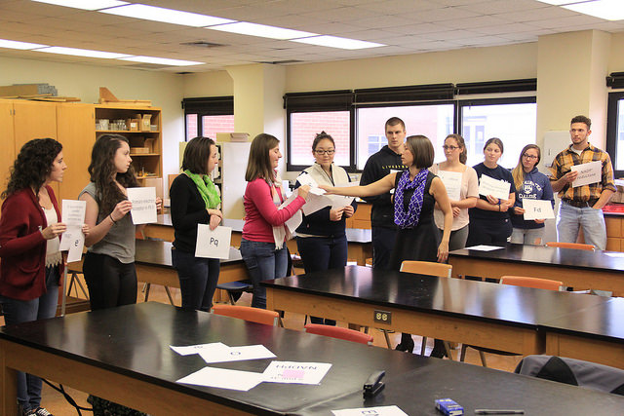
Backward Course Design: Stage 3
Plan Instructional Activities
  How will students learn?
  Active Learning (Meyers & Jones, 1993)
    Increased motivation and longer retention of knowledge (Nilson, 1998)
Notes:
The instructional activities can then be planned based on the goals and assessment. “How will the students learn?” One of the methods that can be helpful for students include active learning. Active learning includes activities that allow students to take an active role in learning instead of being a passive learner. Past research has indicated that there are many positive outcomes from teachers using active learning methods, such as increased motivation and longer retention of knowledge. Active learning also creates a learning-centered environment as opposed to teaching-centered. The responsibility to learn is then shifted to the students.

Slide 12
Integrating literacy using Backward Course Design
Stage 1
  Integrate into the transformational goal and/or learning outcomes
Stage 2
  Assess students’ literacy
Stage 3
  Plan instructional activities that revolve around literacy
Notes:
Literacy can be integrated into each of the stages of backward course design. For instance, a learning outcome, or even the transformational goal, can include literacy. Additionally, assessment methods can be developed to determine whether the students improved their literacy in the course subject. Instructors can then plan instructional activities that revolve around literacy. I will now describe specific ways in which literacy can be integrated using an introductory psychology course as an example, which is the course I designed through the summer CTLT program.

Slide 13
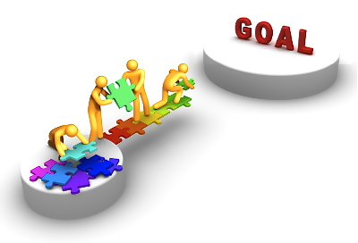
Integrating literacy using Backward Course Design
Stage 1: Transformational Goals
  Main focus of course
    “As a result of this course, my students will be able to apply the content they learned to their lives in various contexts.”
  A part of the course
    “As a result of this course, my students will understand themselves and others better by considering life experiences that have occurred in their lives and other people’s lives.”
Notes:
Again, the first stage is identifying the desired results. If you want literacy to be the main focus of the course, becoming more literate can be the transformational goal for the course. For example, a transformational goal for an introductory psychology course may be, “As a result of this course, my students will be able to apply the psychological information they learned to their lives in various contexts.” However, literacy can be incorporated as a part of the class instead of the main goal of the course. For example, for my intro to psych course, the transformational goal is, “As a result of this course, my students will understand themselves and others better by considering life experiences that have occurred in their lives and other people’s lives.” Although this goal is not explicitly referring to literacy, becoming more literate can help obtain the transformational goal, such as applying information related to the course to understand the self and others better.

Slide 14

Integrating literacy using Backward Course Design
Stage 1: Learning Outcomes
  Understanding the basic concepts of the topic
    Ex: “Students will define and explain the utility of the process of scientific method for research.”
  Think critically
    Ex: “Students will critically interpret and dissect journal articles.”
  Apply concepts to problems
  Learn to search and find credible sources
Notes:
Whether literacy is the main focus of the course or not, the following learning outcomes can be integrated to encourage students’ literacy. To understand what they are reading and writing about, students must become familiar with the basic concepts of the subject. For instance,“Students will define and explain the utility of the process of scientific method for research” is one of the learning outcomes for the course I developed. This is an important learning outcome for students to understand journal articles and how to write a research paper. If the students are reading excerpts about how the brain affects people, the learning outcome “Students will explain how the brain and neurons operate in basic terms” will help them better grasp the information presented. Once the basic concepts are laid out for the students to gain an understanding of what they are reading and writing, it is important for the student to become a critical consumer of the information they come across. The learning outcome “Students will critically interpret and dissect journal articles” for a psychology course, or for any other course for that matter, will encourage students’ reading and writing while ensuring that they will know what information is relevant. On a related note, application of the information is a part of literacy; therefore, students should explicitly learn how to apply the concepts during class to help the students practice the application process. Finally, to acquire information, students must learn to search and find credible sources. Even if the students are able to think critically, they will not be able to write a good paper if they are not able to find and identify credible sources.

Slide 15

Integrating literacy using Backward Course Design
Stage 2: Assessment Methods
  Formative
    Directed Paraphrasing
    1-minute paper
  Summative
    Research papers
    Annotated bibliographies
    Presentations
    Application test questions
Notes:
Both the formative and summative assessment methods can be used to encourage literacy. Some examples of formative assessments that I included in my course are directed paraphrasing and 1-minute papers. Directed paraphrasing involves having students rephrase concepts in their own words. For the 1-minute paper, at the end of each class period, students reflect on their learning and list some questions that remain. Using these methods, instructors are able to determine whether the students are following the right path towards the desired result from the transformational goal. If the students are struggling with the basic concepts, application, or critical thinking, instructors can provide feedback or try different methods of explanation. Additionally, there are many summative assessment methods that will check the students’ overall learning. In my intro to psych course, I included papers, annotated bibliographies, and exams. Students can use their critical thinking skills to write papers, and the students could use their acquired source finding skills to complete research papers and annotated bibliographies while being critical about journal articles. The learning outcome to understand basic concepts and to apply such information can be assessed by having questions that require the students to apply ideas and concepts to reach the correct answer during tests.

Slide 16
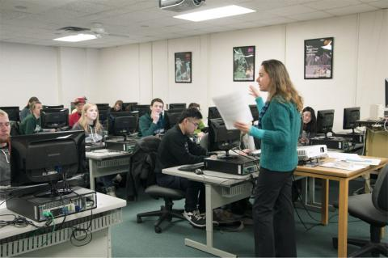
Integrating literacy using Backward Course Design
Stage 3: Instructional Activities
  Active Learning activities
    Discussion Questions
    Clickers
  Collaborate with librarians (Fox & Doherty, 2012)
Notes:
Lastly, for the instructional activities, the instructor may decide whether lecture or discussion, or the combination of the 2, may work best with the content of the course. Adding discussion questions has been shown to be helpful to the students because it is an active learning activity that can engage students. The discussion questions can be created in a way that taps into each of the learning outcomes I addressed. Some questions may require students to use their critical thinking skills. Other questions can be about the students’ understanding of a concept by asking an application question. Such questions can be in discussion format or multiple-choice format that can be answered using technological means, such as Clickers. Clickers can keep students engaged while serving as an activity and a formative assessment method, checking the students’ learning consistently. For these reasons, I included these activities into my course. Finally, to obtain some essential skills to find credible sources, instructors can collaborate with librarians to familiarize students to library resources. Librarians can help students learn how to search for sources efficiently, such as using certain search terms. Furthermore, students can learn to evaluate which sources are credible and how to cite them, which are very useful literacy skills.
Although I listed these goals, assessment methods, and instructional activities to encourage literacy in this presentation with an intro psych course I designed, there are many different ways to encourage literacy in your classroom that works better for that topic.

Slide 17
Outline
Encouraging literacy
Modification in the classroom
Scientific literacy

Slide 18

Implementing backwards course design
The course design I developed during the Instructional Design for Future Faculty summer cohort was implemented in my Fall 2017 IDS 121.19 course.
Transformational Goal: As a result of this course, students will be able to critically engage with texts they encounter to determine the merit of the ideas being represented within the text.

Slide 19

Issues I ran into
Students did not have the background knowledge I expected them to have.
Some students were not as invested in the topic as I expected.
Some students did not have basic critically reading skills.

Slide 20
Student feedback activities
Notecards
  One thing you understand well
  One thing you understand a little but need to go over again
  One thing you don’t understand at all
Survey Monkey
  Can have varying levels of anonymity (name, IP address, or other identifying information)
Midterm Chat
  Service offered through CTLT

Slide 21
Results of adapting course design
Students better understood the course content and achieve learning outcomes.
Modifying the course led to mutual trust and respect between instructor and students.
Students reported being satisfied with the course.

Slide 22
Outline
Encouraging literacy
Modification in the classroom
Scientific literacy

Slide 23
Scientific Literacy
What is scientific literacy?
Why does it matter in education?
Research in scientific literacy at ISU
Using backwards course design in research

Slide 24
What is scientific literacy? (National Research Council, 1996)
identify scientific issues involved in policy decisions and express positions that are scientifically and technologically informed
evaluate quality of scientific information and arguments based on sources used
read articles about science in the general media
construct evidence-based arguments and appropriately apply conclusions from arguments
“knowledge and understanding of scientific concepts and processes required for personal decision making, participation in civic and cultural affairs, and economic productivity”
describe, explain, and predict natural phenomena
ask questions based upon curiosity about everyday experiences and find answers to these questions
engage in conversation about scientific concepts and issues
Notes:
National Research Council. 1996. National Science Education Standards. Washington, DC: The National Academies Press. https://doi.org/10.17226/4962.

Slide 25
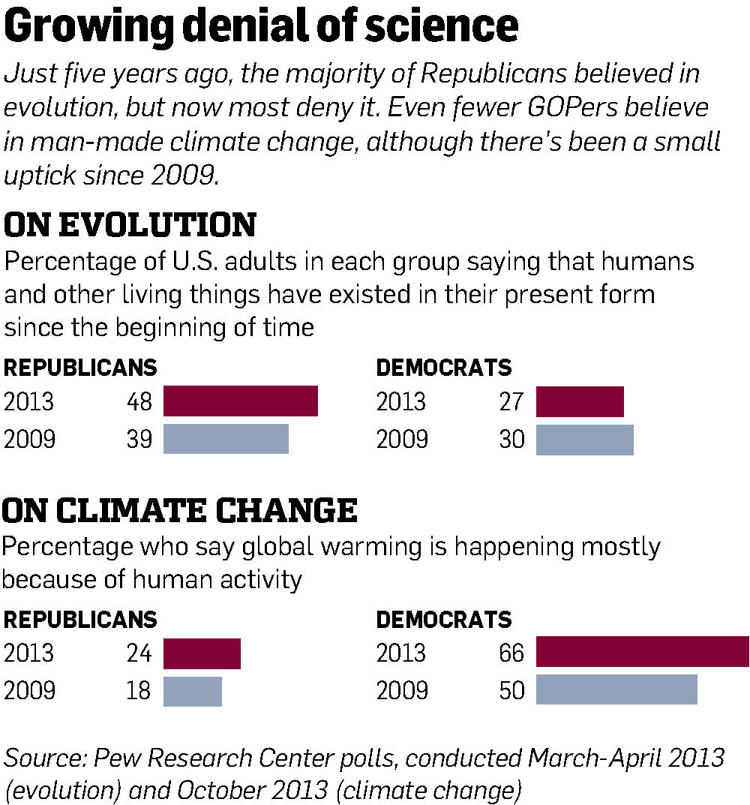

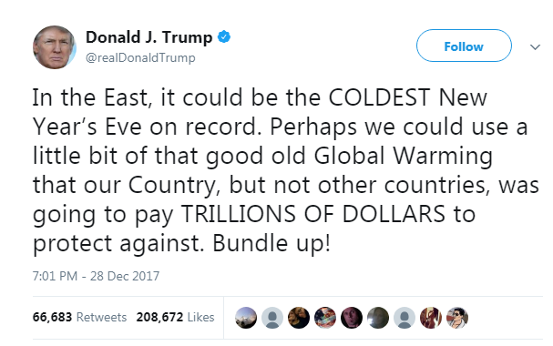
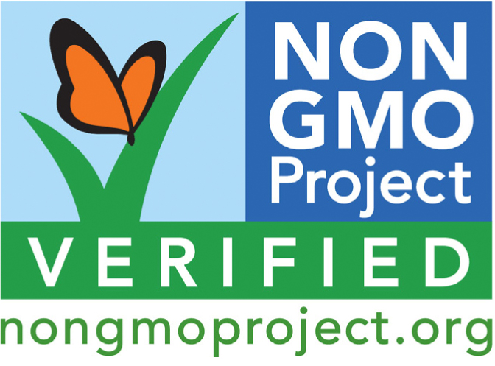
Why does scientific literacy matter?
Notes:
https://socioecohistory.files.wordpress.com/2013/01/anti_vaccine_postcard.jpg?w=500&h=350
https://gmoawareness.files.wordpress.com/2013/02/non-gmo-proj.jpg
http://media.nj.com/njv_editorial_page/photo/ed0103editaboxjpg-61bf18ee8be57b7b.jpg

Slide 26
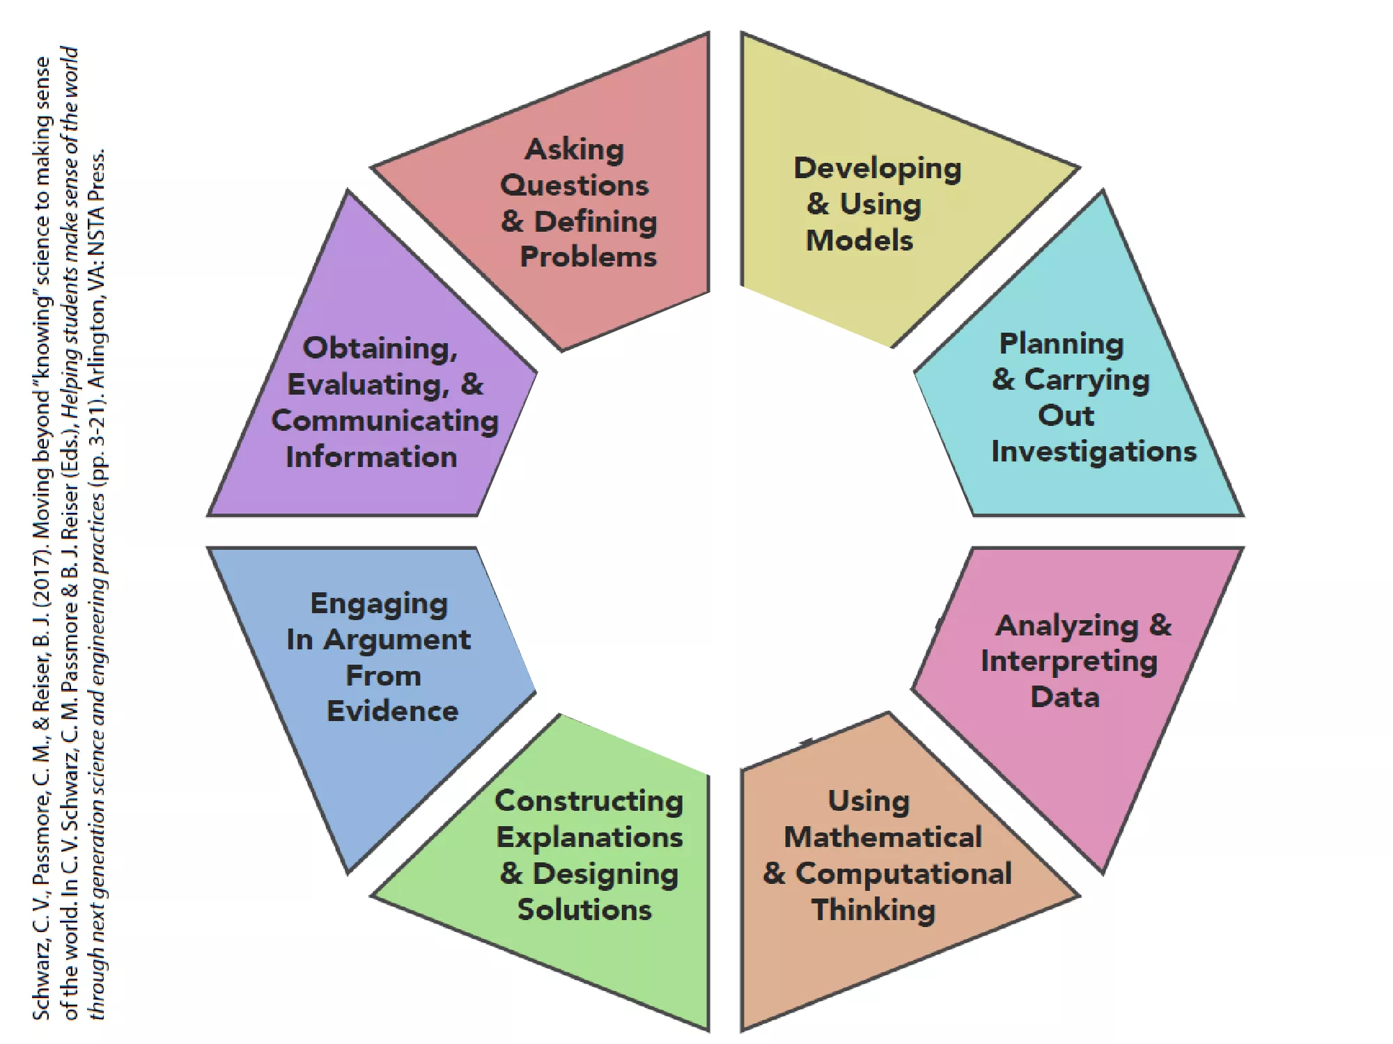
Why does scientific literacy matter in education?
Foundational goal in science education (Dillon, 2016)
Science and Engineering Practices (NGSS)
Common Core Standards for Literacy
  Specific strands for Science & Technical Subjects
Most students’ science education ends in high school or with a general course in college
  Prepare pre-service teachers
  Transform general education college courses
Notes:
Dillon, J. (2016). 17 On Scientific Literacy and Curriculum Reform. Towards a Convergence Between Science and Environmental Education: The Selected Works of Justin Dillon, 269.
https://i0.wp.com/corelaboratewa.org/wp-content/uploads/2017/12/aac4d96694c646f49349a220cdc9d72b-0.png

Slide 27
Research in scientific literacy at ISU
Research to Establish a Scientifically Informed SocieTy
  Overarching goal: identify instructional strategies that improve the scientific literacy of nonscientist members of the public
Teaching for Transformative Experiences in Science (TTES) model (Pugh, 2002; Pugh, 2011)
  Science education should be applicable to students’ everyday lives
  Evolutionary understanding increases when conceptual change occurs
  Transformative experiences occur when students actively use concepts in their daily lives, prompting them to understand and experience the world in a different way
  General education course taught entirely from an evolutionary perspective using TTES model to foster conceptual change and transformative experiences

Slide 28
Using course design in research
Implementation of TTES model through design-research approach (Cobb et al., 2003)
Required restructuring BSC 101 curriculum
Instructional Design for Future Faculty
Fall 2017
Spring 2018
Fall 2018
Spring 2019
Pilot TTES curriculum in honors section
Collect additional data from traditional section
Collect additional data from traditional and honors sections
Implement TTES curriculum in general education section
Notes:
Cobb, P., Confrey, J., DiSessa, A., Lehrer, R., & Schauble, L. (2003). Design experiments in educational research. Educational researcher, 32(1), 9-13.

Slide 29
Backwards Course Design
Stage 1
Stage 2
Stage 3
Identify Desired Results
Determine Methods of Assessment
Plan Instructional Activities
1
2
3
Notes:
Desired results: become more scientifically literate citizens … then went through whole workshop basically designing my research with this ultimate goal of improving the scientific literacy of nonscientist members of the public

Slide 30
BSC 101 TTES Course Design
Stage 1: Integrate literacy into transformational goal and learning outcomes
  Student will be able to use their knowledge of biological concepts and evolutionary theory to recognize, evaluate, and appreciate how evolution has shaped and will continue to shape the world around them.
  Critically assess, determine the validity of, and interpret information; refute pseudoscientific and antiscientific claims with authentic data; identify and reevaluate alternative conceptions of scientific principles
Stage 2: Assess students’ literacy
  Formative: instructional activities (example: constructing and analyzing food web)
  Summative: presentations and unit exams (questions constructed to assess application and analysis of material rather than memorization)
Stage 3: Plan instructional activities involving literacy
  Case studies, authentic data analysis, evaluating claims

Slide 31
Questions?

