Slide 1

Millennial College Students: What Keeps Them Engaged in Classroom?
Dr. Iuliia Tetteh, Dr. Aslihan Spaulding*, Dr. Yangxuan Liu**, and Michael Miner***
*Department of Agriculture, Illinois State University, **Department of Agricultural Economics, University of Georgia, and
***Undergraduate student in Agribusiness at Illinois State University.

Slide 2


Roadmap
Motivation for research
Background information
Methodology
Results & implications
Further research

Slide 3


MOTIVATION FOR RESEARCH

Slide 4
Motivation for research
In-class observations of millennial students’
- behaviors (e.g., impatience, urgency to find a solution, frequent use of electronics, etc.)
- attitudes (e.g., reluctance to participate in class if not interested in the material)
Discussion with colleagues
Literature review

Slide 5
Background
Who are millennials?
Individuals who were born between 1982 and 2000, who are currently between 18 and 35 years old (Federal Reserve Bank of Atlanta, 2014).
By 2020, millennials will constitute 40% of global workforce (Pricewaterhouse Coopers, 2011).
By 2030, millennials will constitute 75% of the U.S. workforce (U.S. Bureau of Labor Statistics, 2017)
Notes:
Raised in “just-in-time” service oriented culture, current live in a file-sharing cut-and-paste world

Slide 6
Background
How are they different?
Exhibit difference attitudes, preferences, and work habits (Price, 2009; Borges, 2006; Oblinger, 2004, etc.)
- have low tolerance for delay
- expect almost immediate feedback and recognition
- crave structure and do not like ambiguity
- require strong work/life balance
- place a primary emphasis on their personal needs
- never read instructions
- strongly prefer learning by doing
- believe multitasking is an effective use of their time
- the most college educated generation
Notes:
Raised in “just-in-time” service oriented culture, current live in a file-sharing cut-and-paste world

Slide 7
Background
What is the Issue?
63% of students claimed they used electronic devices in class to stay connected rather than engage in class (McCoy, 2016).
30% of millennial college students said they were constantly distracted in class by their technology related to non-educational usage (Schaffhauser, 2016). Two years later, the follow-up survey revealed that the percent increased to 34%.
Nine out of ten students agreed that they “didn’t pay attention” or “missed instructions” because they were using unrelated social media platforms in class (Schaffhauser, 2016).
Notes:
Raised in “just-in-time” service oriented culture, current live in a file-sharing cut-and-paste world

Slide 8
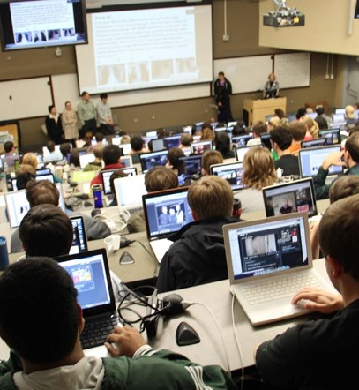
Problem Statement
Changes in millennials’ preferences, attitudes, and work habits can potentially make traditional teaching strategies ineffective.
There is a need for a better understanding of what elements of teaching-learning ecosystem help millennials stay interested and engaged in college classroom.
Notes:
Raised in “just-in-time” service oriented culture, current live in a file-sharing cut-and-paste world

Slide 9



Methodology
Online survey instrument, IRB 1071644-2
Two public non-land-grant universities (Illinois State University and Eastern Kentucky University)
750 Agriculture students (600 at ISU, 150 at EKU)
Administration of survey
- six-weeks data collection period
- three email reminders
- AGR 109
Incentive: Free access code for Motivators Assessment
Response rate 20% (165 respondents, 147 complete)

Slide 10
Methodology
Structure of the survey:
  Section I: Demographic characteristics
  Section II: Teaching methods and instructor’s characteristics
  Section III: Course content
Sections II and III were constructed based off the Five R’s Model (Price 2011).
Notes:
Five R’s Model for engaging millennial students. The model focuses on the following areas of the teaching-learning environment: (1) research-based methods, (2) relevance, (3) rationale, (4) relaxed learning environment, and (5) rapport (Price 2011).

Slide 11
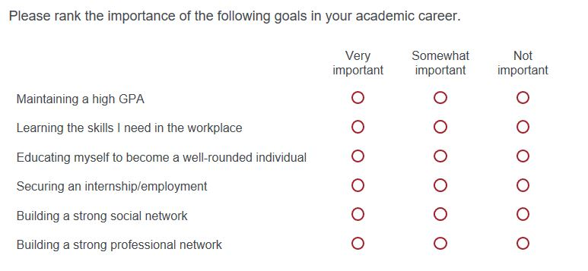
Sample Questions

Slide 12
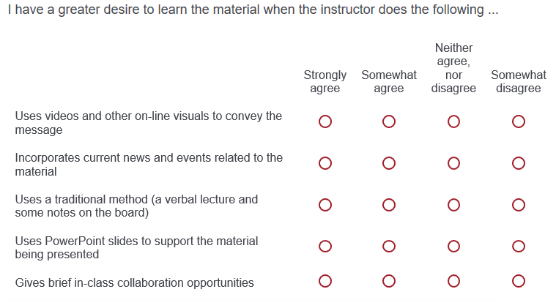
Sample Questions

Slide 13
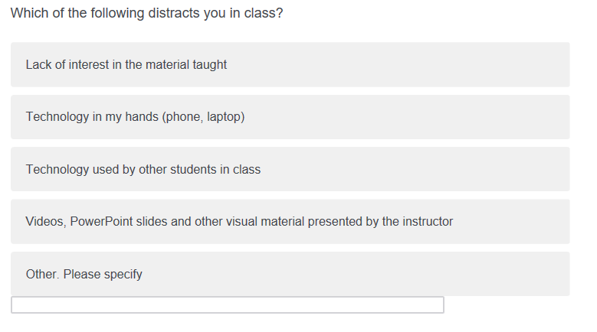
Sample Questions

Slide 14
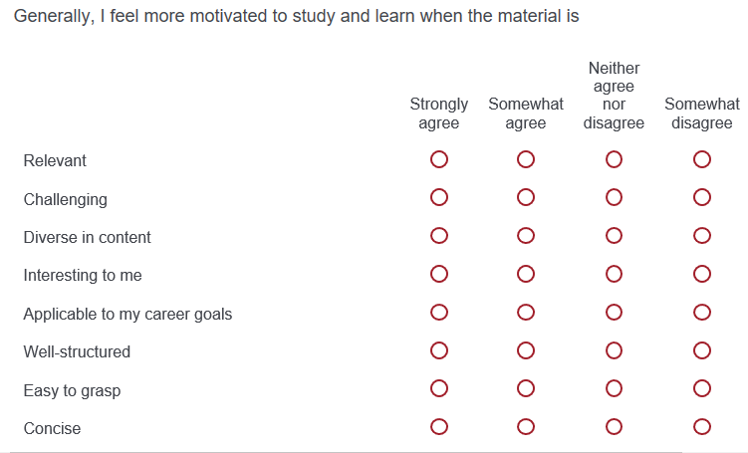
Sample Questions

Slide 15

Data analysis
Summary statistics
Frequency and percentages analysis
Cross tabulation
Chi-square test

Slide 16
Results
147 complete responses (67% female, 32% male, 1% did not respond).
Top 3 majors: agribusiness management (65%), animal science (25%) and agronomy (23%).

Slide 17
Results
Question | % of respondents selected “Yes”
Are you a self-motivated individual? | 93.9
Do you participate in student clubs? | 70.0
Do you have any international experience? | 12.9
Do you work in summer? | 93.2
Do you work during the school year? | 76.2
Are you a first generation college student? | 36.7
Do you come from a single-parent household? | 19.7
Do you have siblings? | 90.5
Notes:
The next three slides describe the surveyed students, than we will look at (2) instructor-related and (3) teaching strategy-related questions, and (4) material-related questions.

Slide 18
Results
Question | N | Minimum | Maximum | Mean | Std. Deviation
How old are you? | 146 | 18 | 49 | 21.2 | 3.6
What is your current cumulative Grade Point Average (GPA)? | 131 | 1.7 | 4.00 | 3.3 | 0.5
How many siblings do you have? | 146 | 0 | 7 | 2.0 | 1.3
Number of organizations | 131 | 0 | 4 | 1.1 | 1.1
Notes:
Do we need Ag GPA? To compare

Slide 19
Results
Notes:
The star is to indicate the significantly higher level of agreement to this question.
Observation/Insight from the graph: Students seem to want to do well to achieve their goals (personal and career), and are not driven primarily by the monetary reward.

Slide 20
Results
Notes:
The star is to indicate the significantly higher level of agreement to this question.
Observation/Insight from the graph: Students are motivated by relevance of the material rather than recognition. They also do not like working with others on joint projects.

Slide 21
Results
Notes:
This is an instructor-related question.
Observations: Passion, ability to relate material to the real-world and interest in my success are Key motivators.

Slide 22
Results
Notes:
This and the next two slides are teaching strategy-related questions.
Observation/Insight from the graph: students are not necessarily interested in searching for the answer on their own, rather expect help and guidance/direction from the instructor. and direction and like student discussions in class. Therefore, we asked a more in-depth question on the autonomy

Slide 23
Results
Notes:
Almost half of students still want hand-holding approach to teaching/learning. However, 50% would prefer a structured autonomy which may potentially imply that students start wanting to shift from the helicopter parents type of instruction (“tell me what and when to do, and I will do it”) but not to a complete autonomy.

Slide 24
Results
Notes:
Stay informed and keep up with current news in teaching seems to be the dominant factor for students’ interest in the course material.

Slide 25
Results
Notes:
This is the material-related question
Confirming the previous question, students are more interested and motivated when they learn the material which is applicable, relevant and interesting.
Students do not seem to be very motivated by the challenging material.

Slide 26
Results
Statistical analysis
  Challenging material and further exploration of topics motivate students from single-parent household.
  Students who work during the summer to support themselves are motivated with in-class collaboration opportunities, working with peers in group projects, and recognition/awards.
Notes:
Material-related question: confirming the previous question, students are more interested and motivated when they learn the material which is applicable, relevant and interesting.
Students do not seem to be very motivated by the challenging material.

Slide 27
Conclusions
Students seem to be driven by intrinsic (achieve personal goals) rather than extrinsic (higher salary) motivators.
Teaching-learning ecosystem can help students be interested and engaged in the classroom?
Material: relevant and applicable.
Instructor’s characteristics: passionate, informed, and interested in student success.
Teaching strategy: instructor provides structured autonomy and incorporates current developments/news in the course material.
Whenever possible, demonstrate the relevance of course material to students’ experiences, frames of reference, and future careers.

Slide 28




Further Research
Next step: Conduct the survey at four other public (non-land grant) universities.
  Murray State University
  Kent State University - Tuscarawas
  University of Central Missouri
  University of Tennessee at Martin

Slide 29

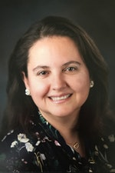
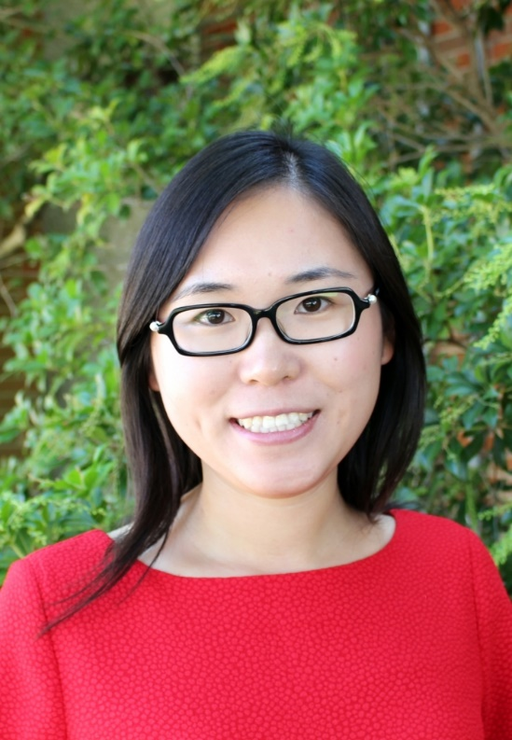

Our research team
Dr. Iuliia Tetteh Assistant Professor of Agribusiness Department of Agriculture Illinois State University | Dr. Aslihan Spaulding Professor of Agribusiness Department of Agriculture Illinois State University
Dr. Yangxuan Liu Assistant Professor Department of Agricultural Economics University of Georgia | Michael Miner Undergraduate student in Agribusiness Department of Agriculture Illinois State University

